Slide 1
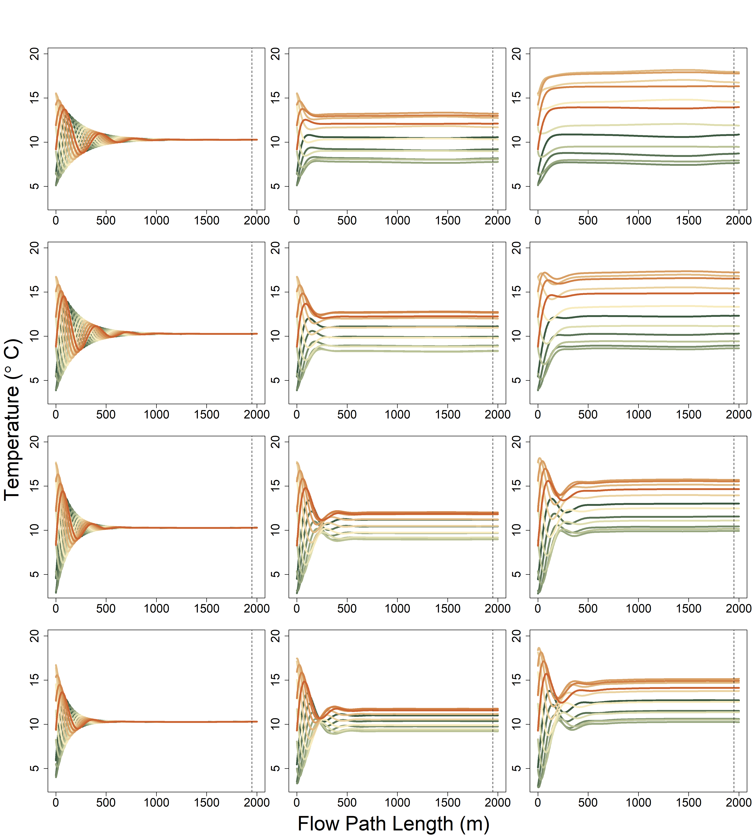
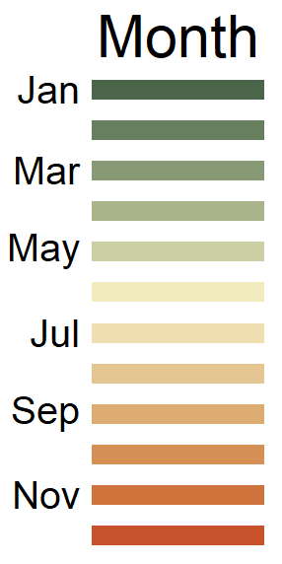
River Only
Shady
Sunny
0.5 m
1.0 m
Unsaturated zone Thickness
2.0 m
3.0 m

Slide 2
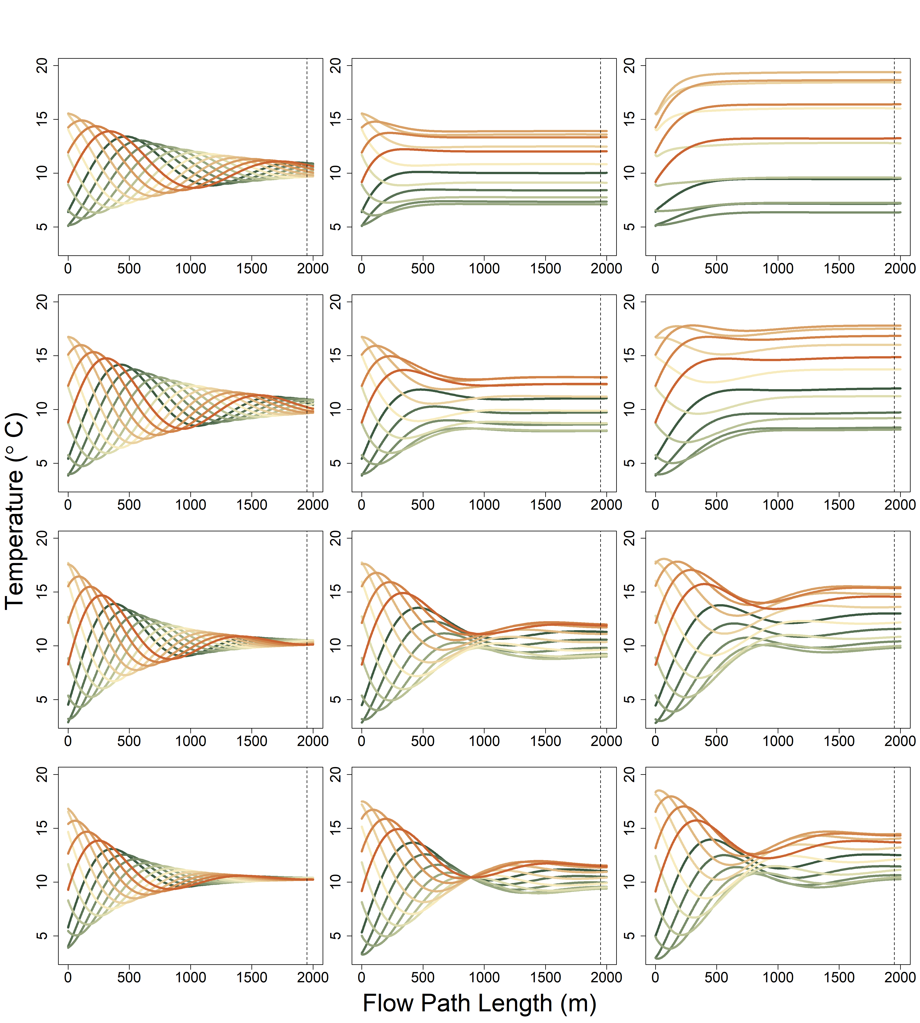
River Only
Shady
Sunny
0.5 m
1.0 m
Unsaturated zone Thickness
2.0 m
3.0 m

Slide 3
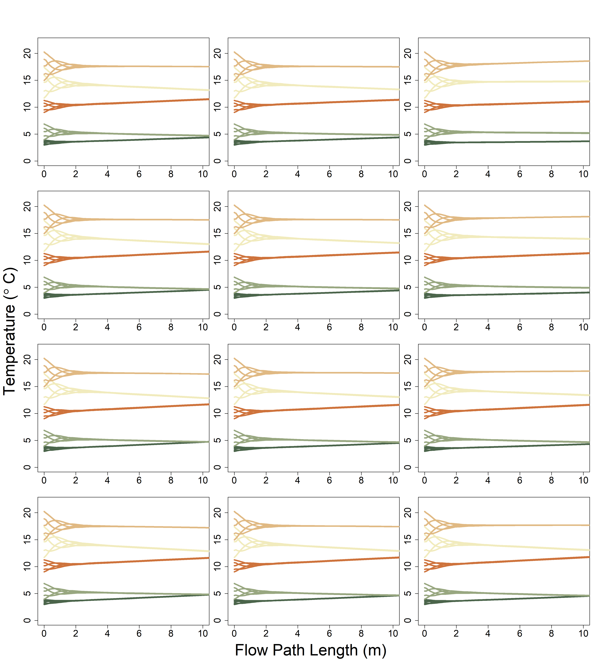
River Only
Shady
Sunny
0.5 m
1.0 m
Unsaturated zone Thickness
2.0 m
3.0 m

Slide 4
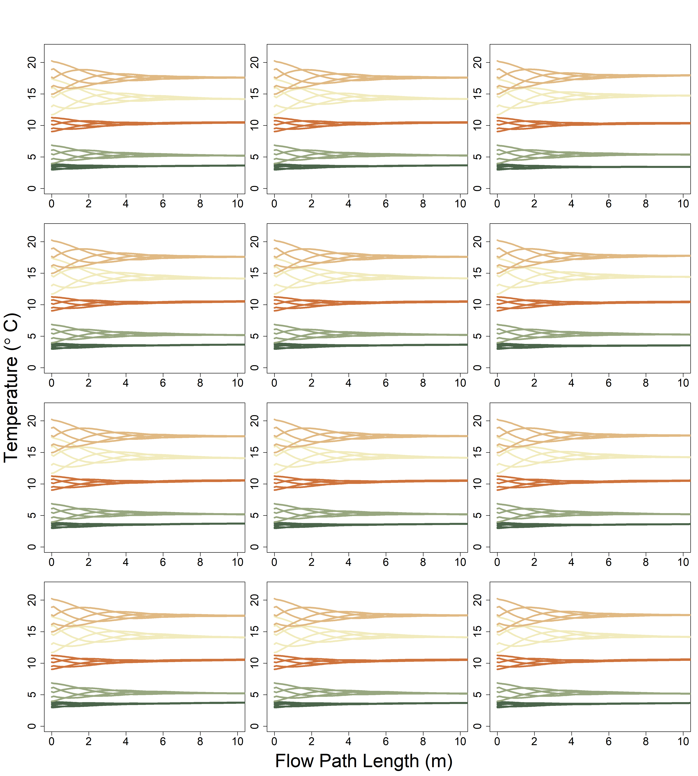
River Only
Shady
Sunny
0.5 m
1.0 m
Unsaturated zone Thickness
2.0 m
3.0 m

Slide 5
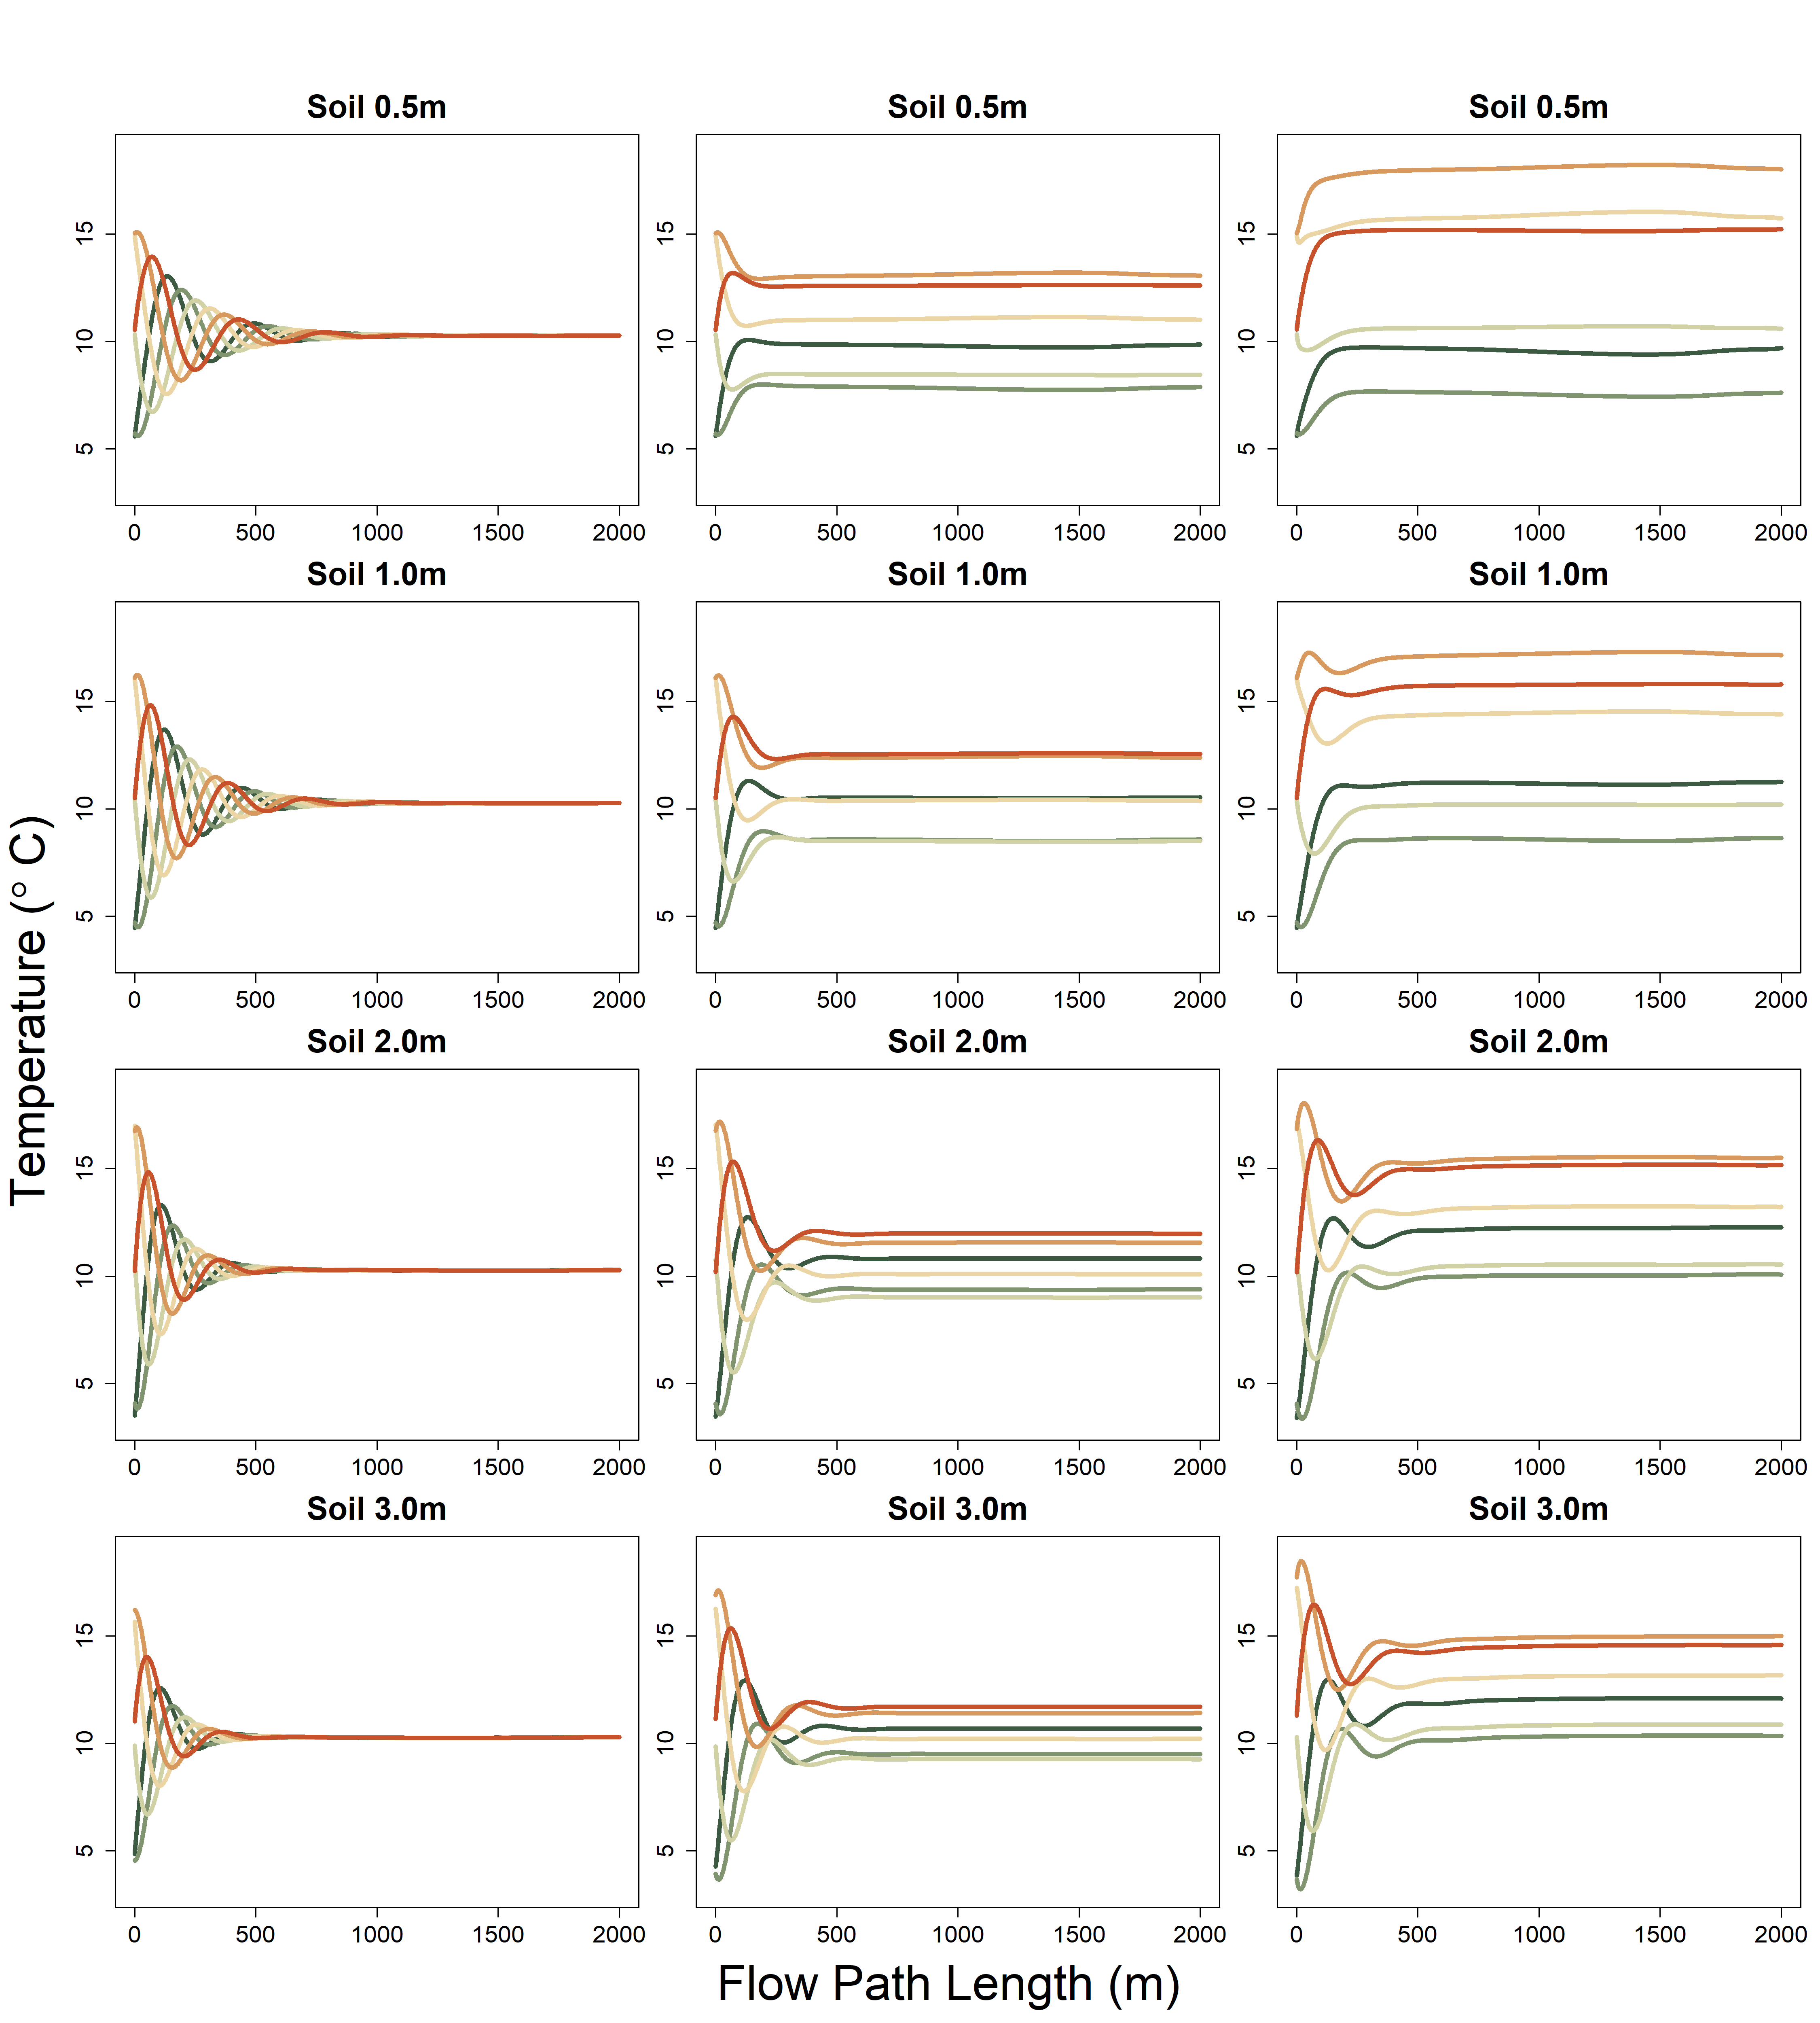
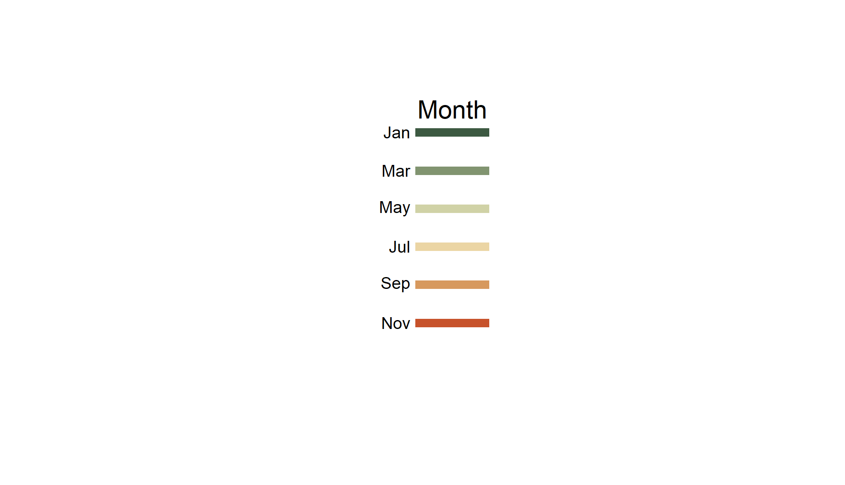

River Only
Shady
Sunny

Slide 6
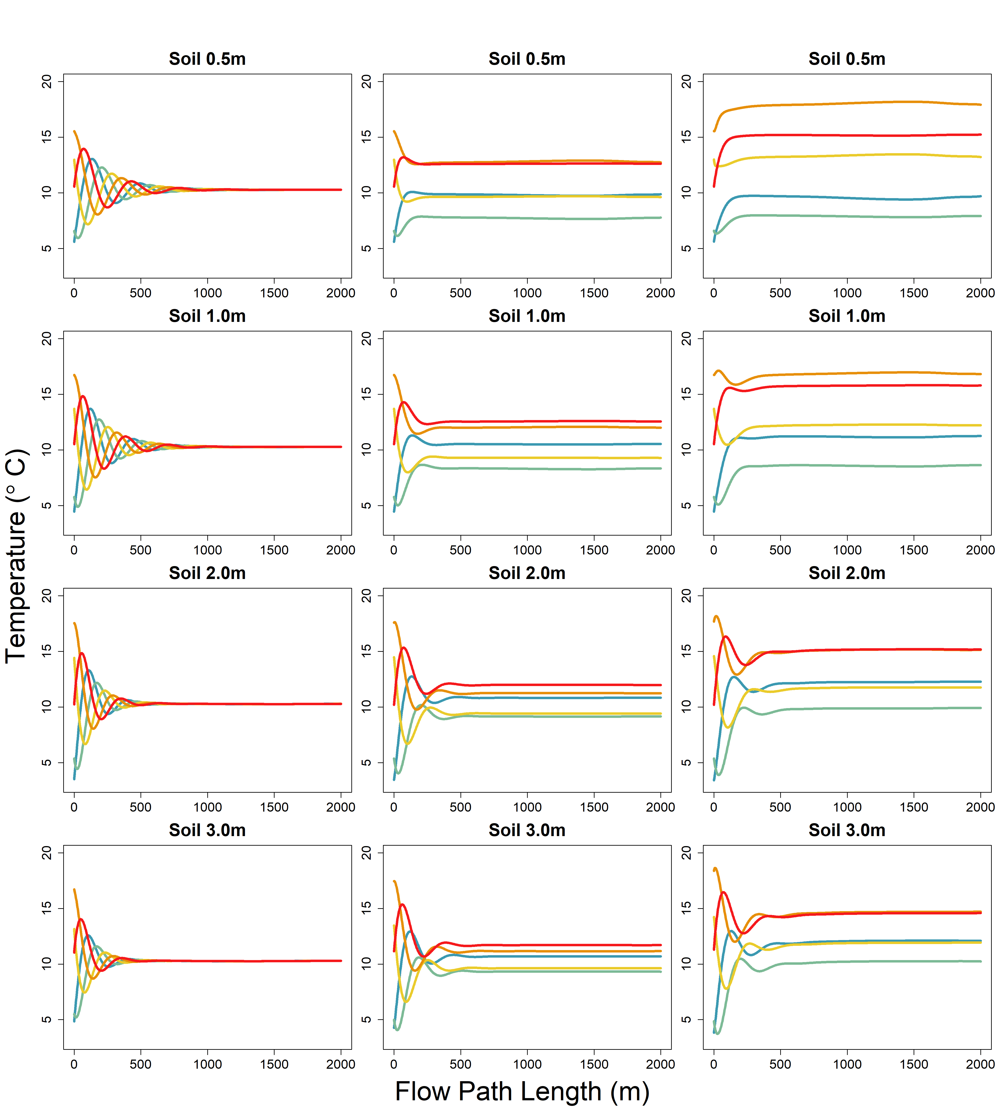
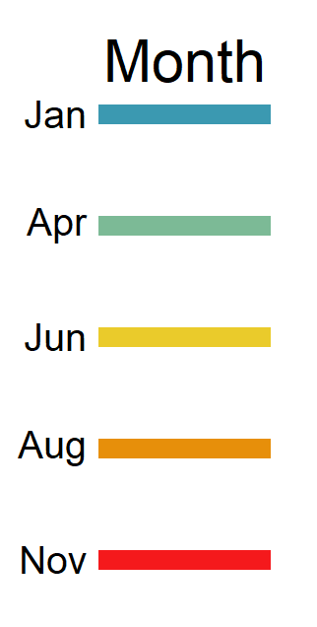
River Only
Shady
Sunny

Slide 7
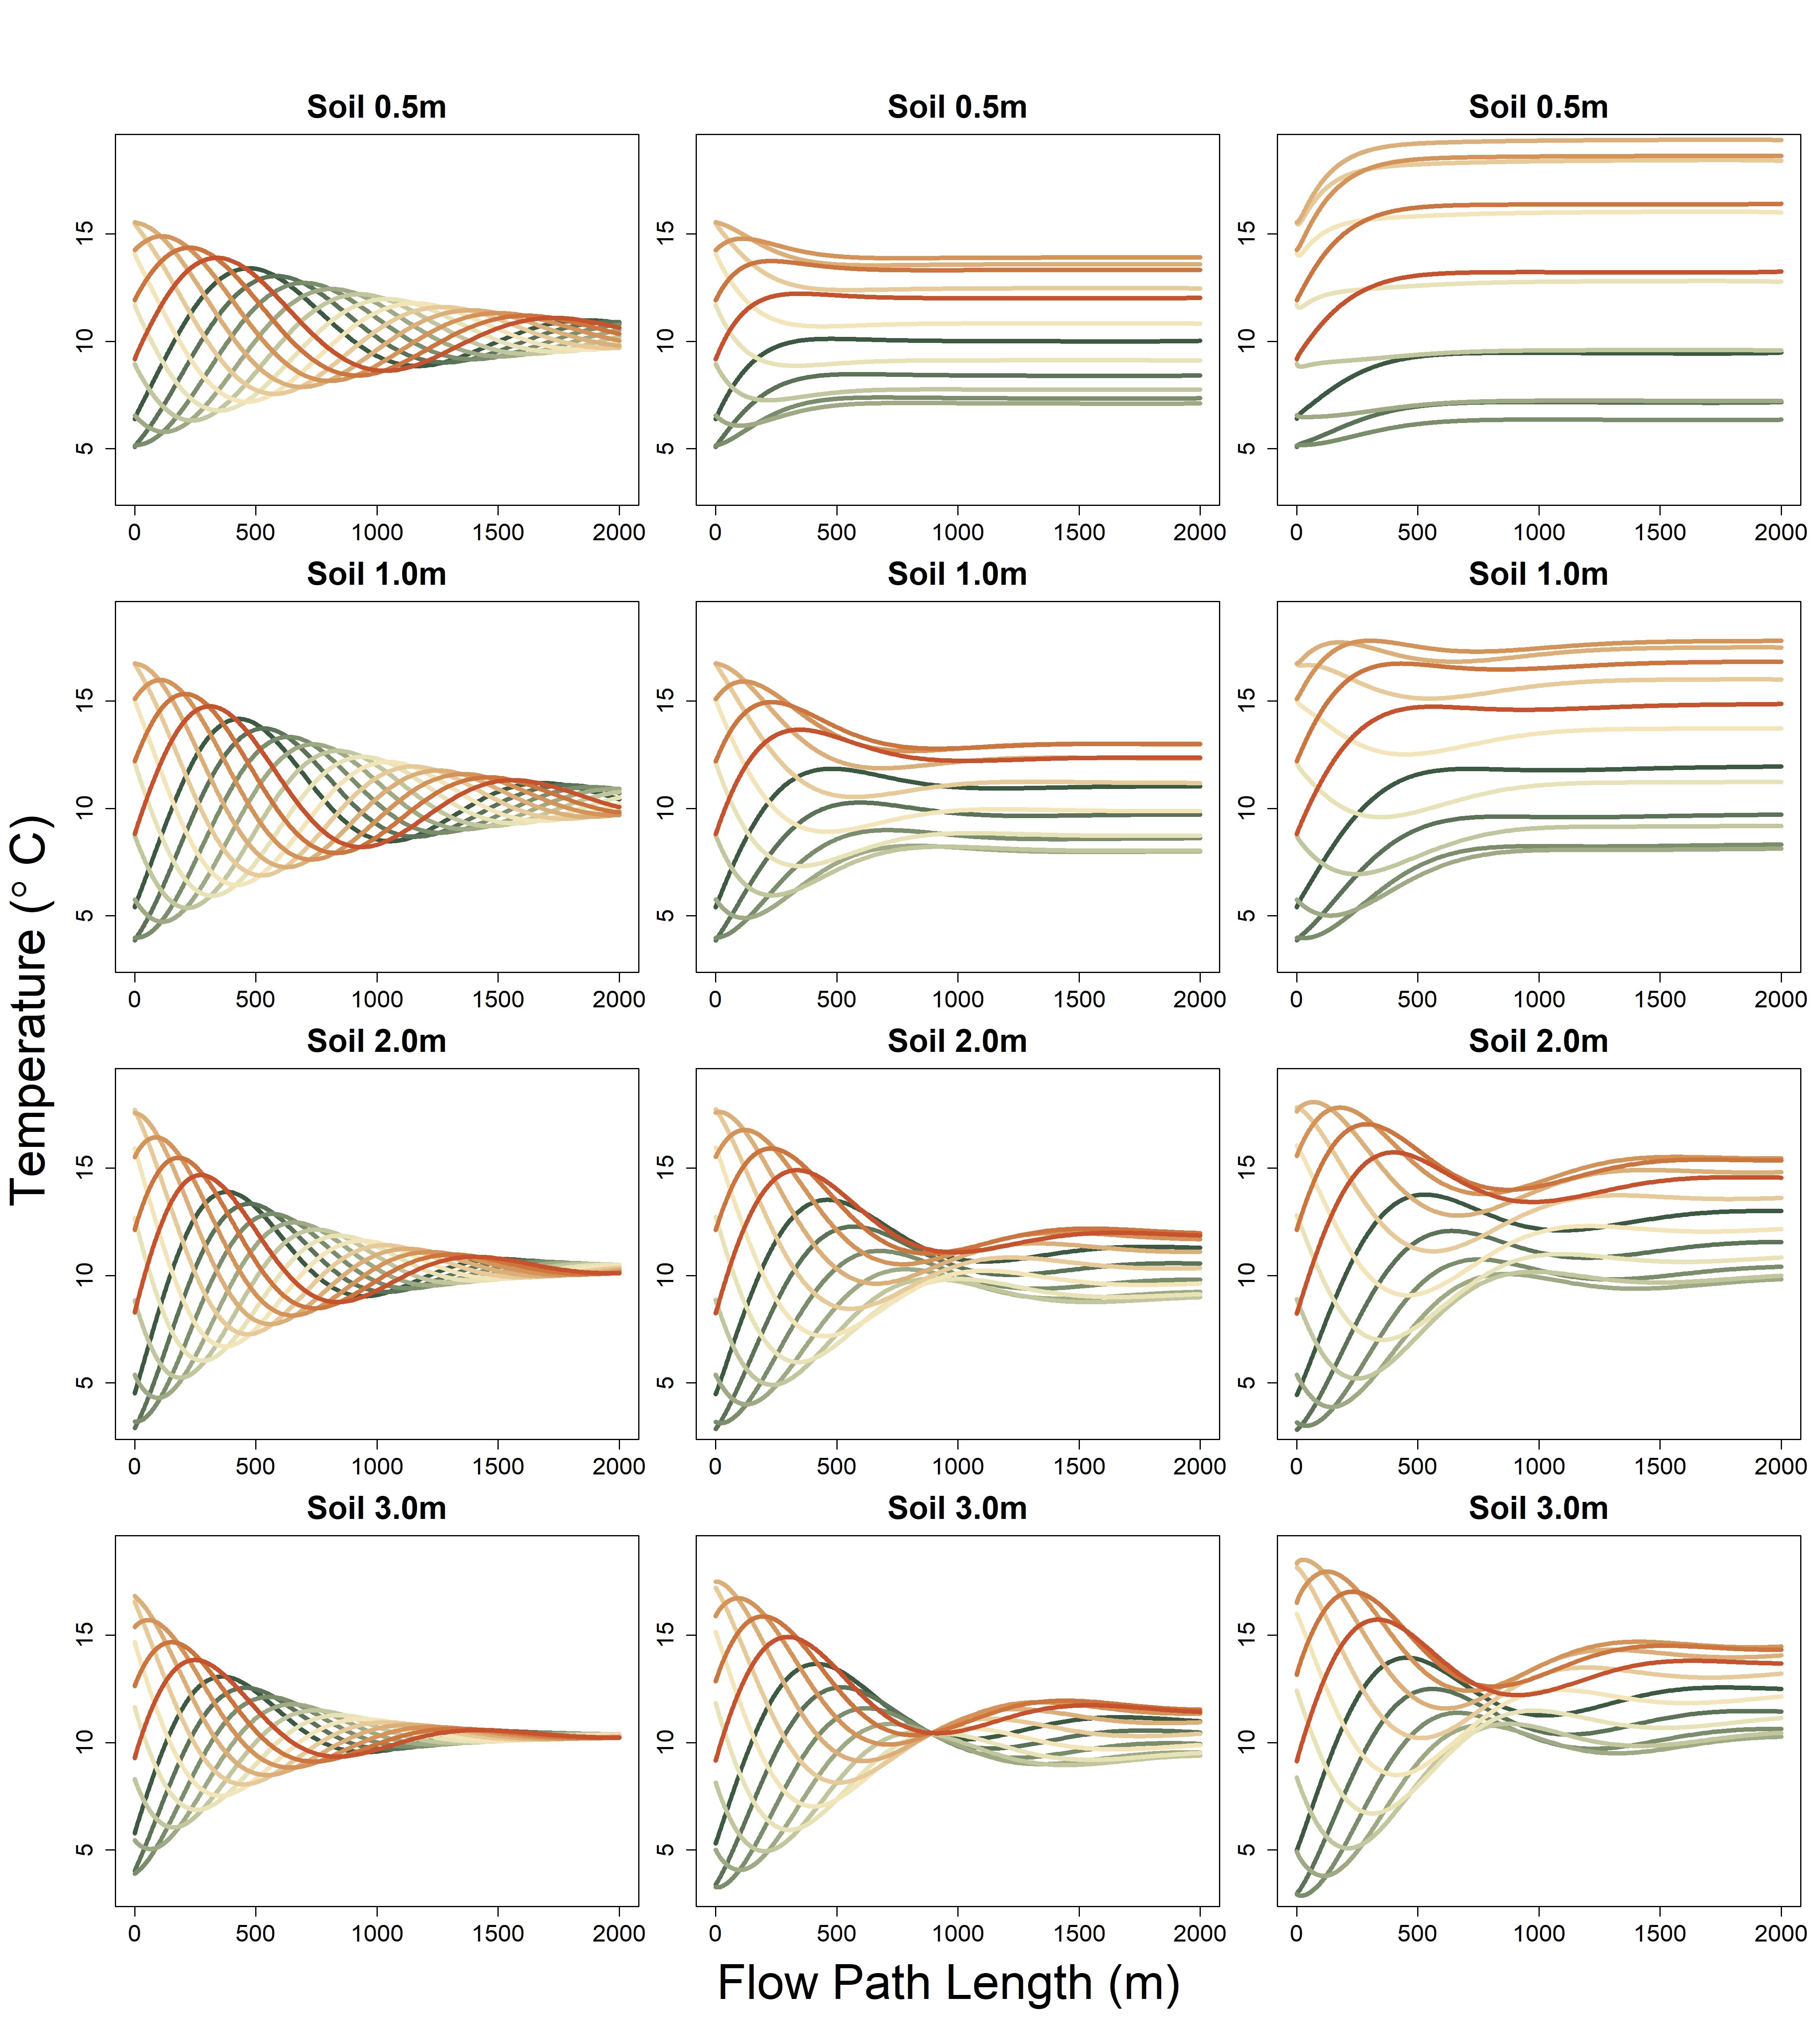
River Only
Shady
Sunny
K= 400 m day-1
Model run with max x = 2000

Slide 8
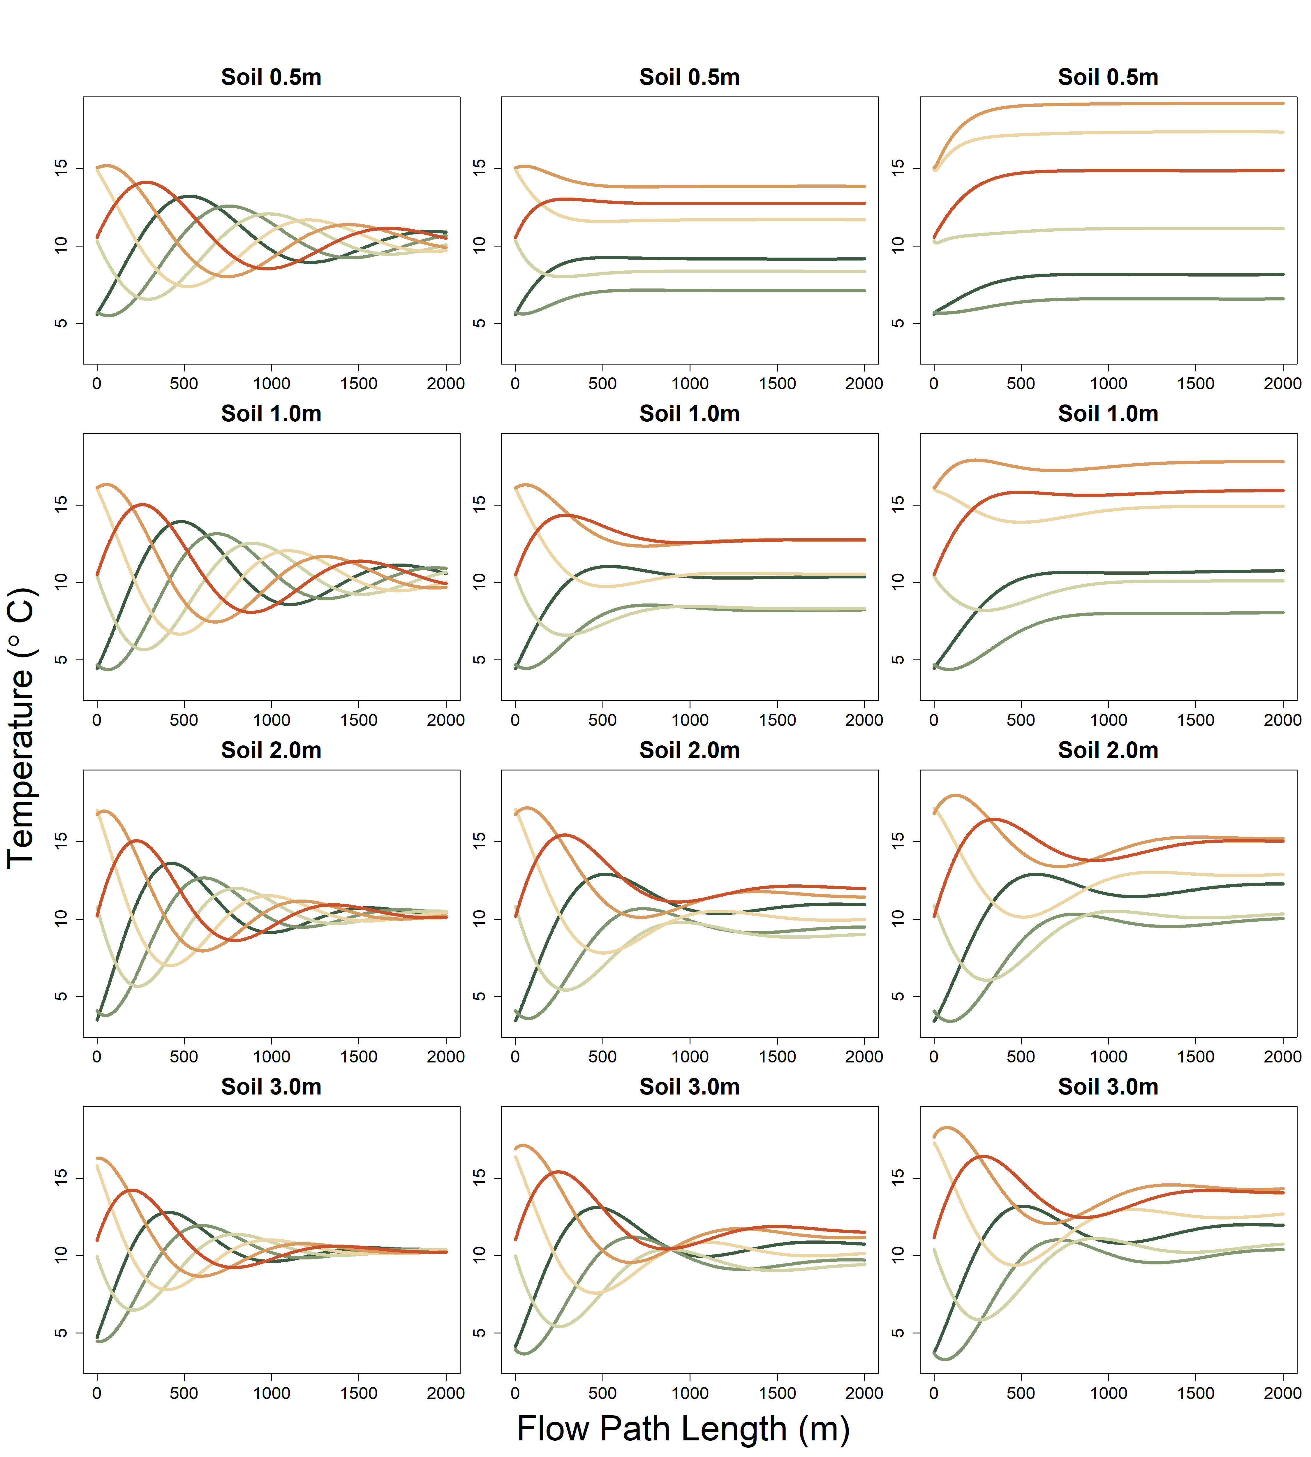
River Only
Shady
Sunny

Slide 9
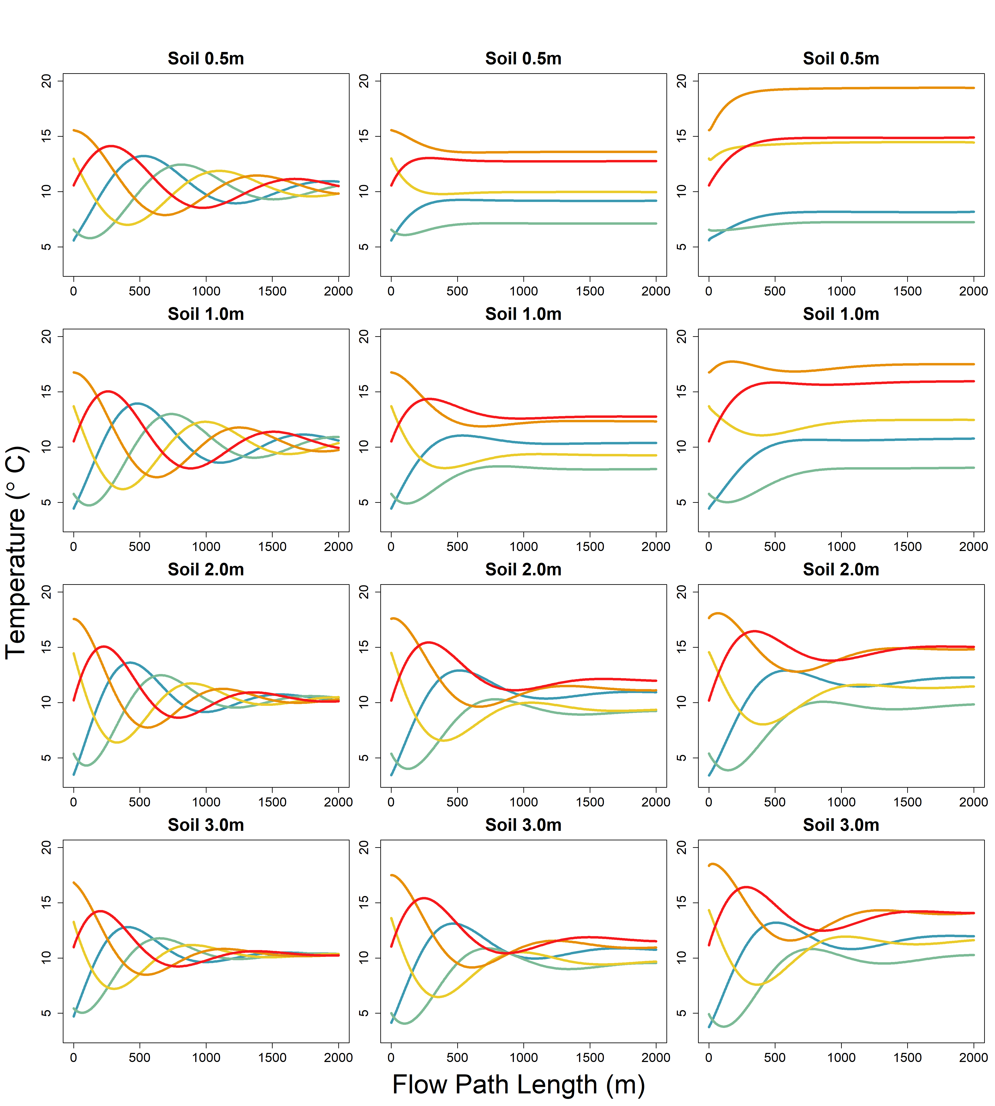
River Only
Shady
Sunny

Slide 10
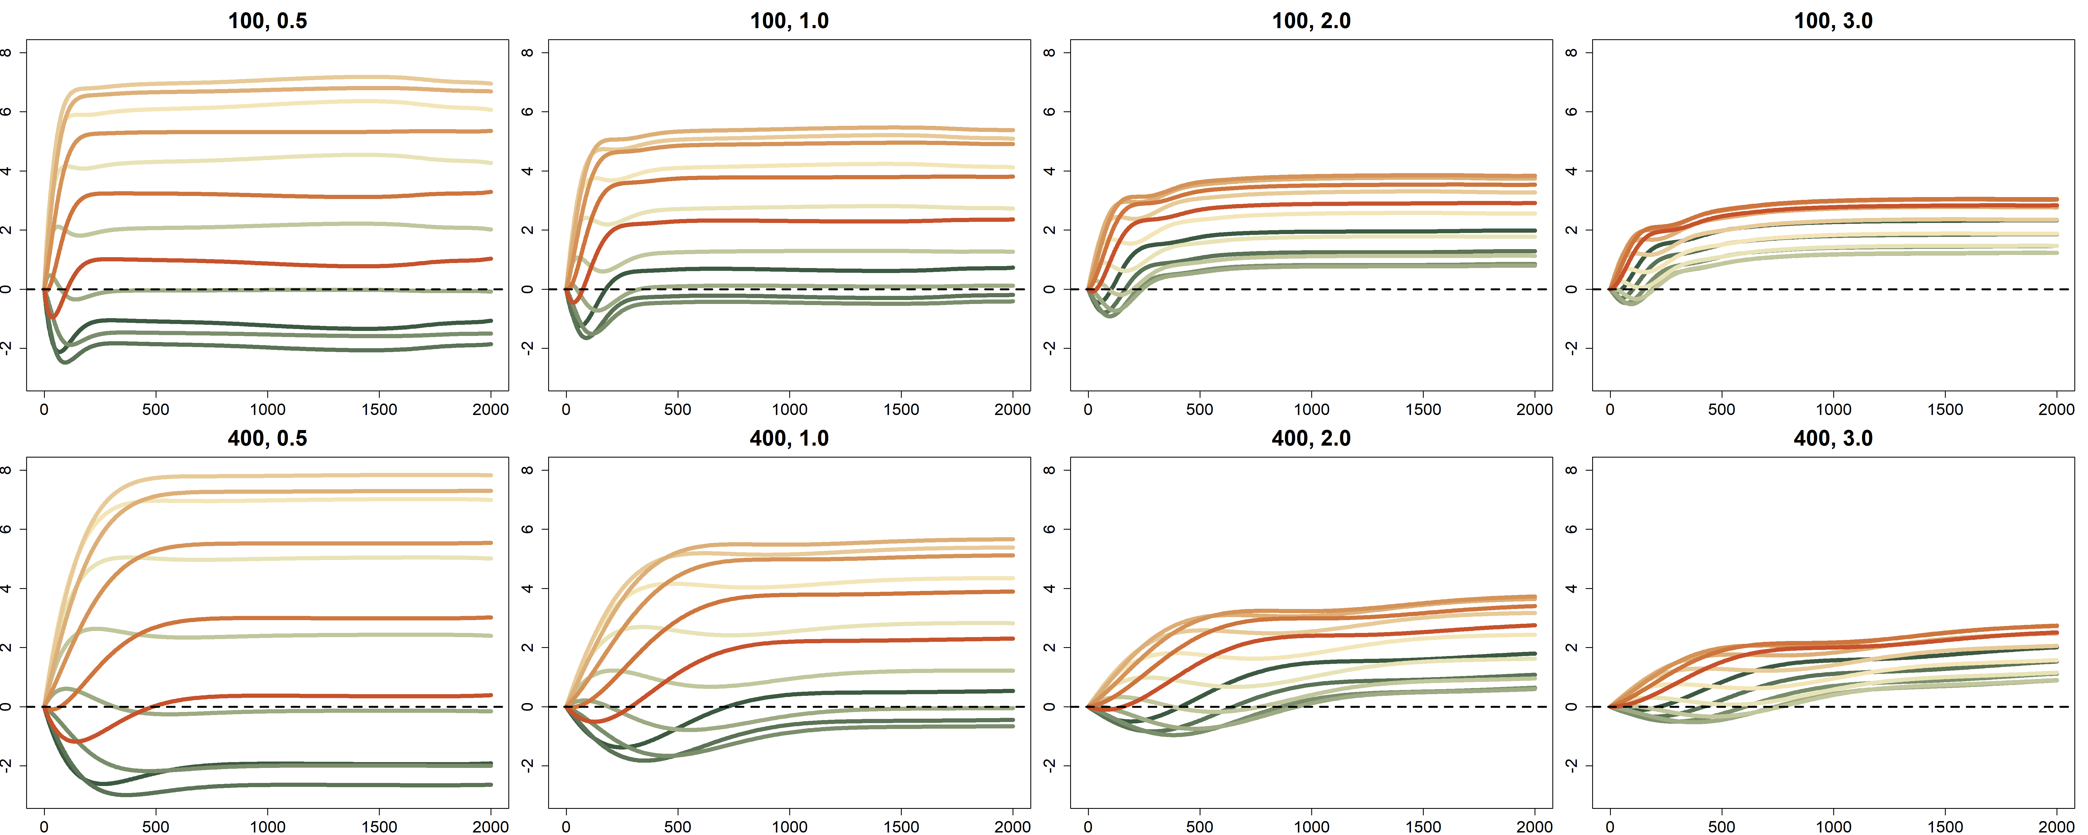
A
Soil 0.5m
Soil 1.0m
Soil 2.0m
Soil 3.0m
Temperature Difference (°C)
B
Soil 0.5m
Soil 1.0m
Soil 2.0m
Soil 3.0m
Temperature Difference (°C)
Flow Path Length (m)

Slide 11
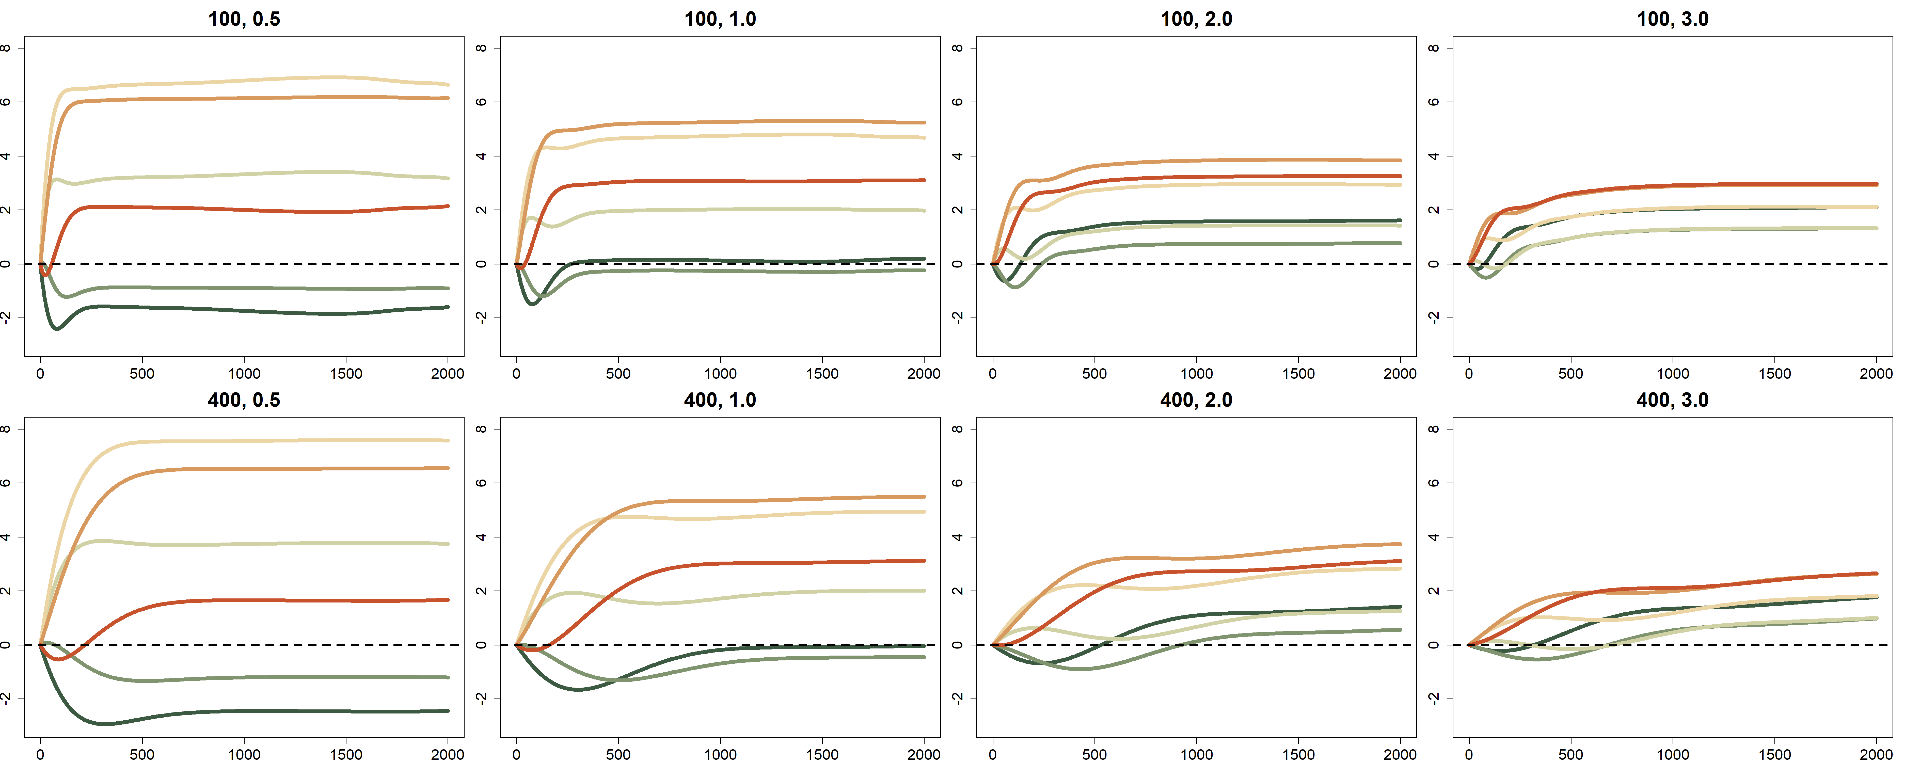
A
Soil 0.5m
Soil 1.0m
Soil 2.0m
Soil 3.0m
Temperature Difference (°C)
B
Soil 0.5m
Soil 1.0m
Soil 2.0m
Soil 3.0m
Temperature Difference (°C)
Flow Path Length (m)

Slide 12
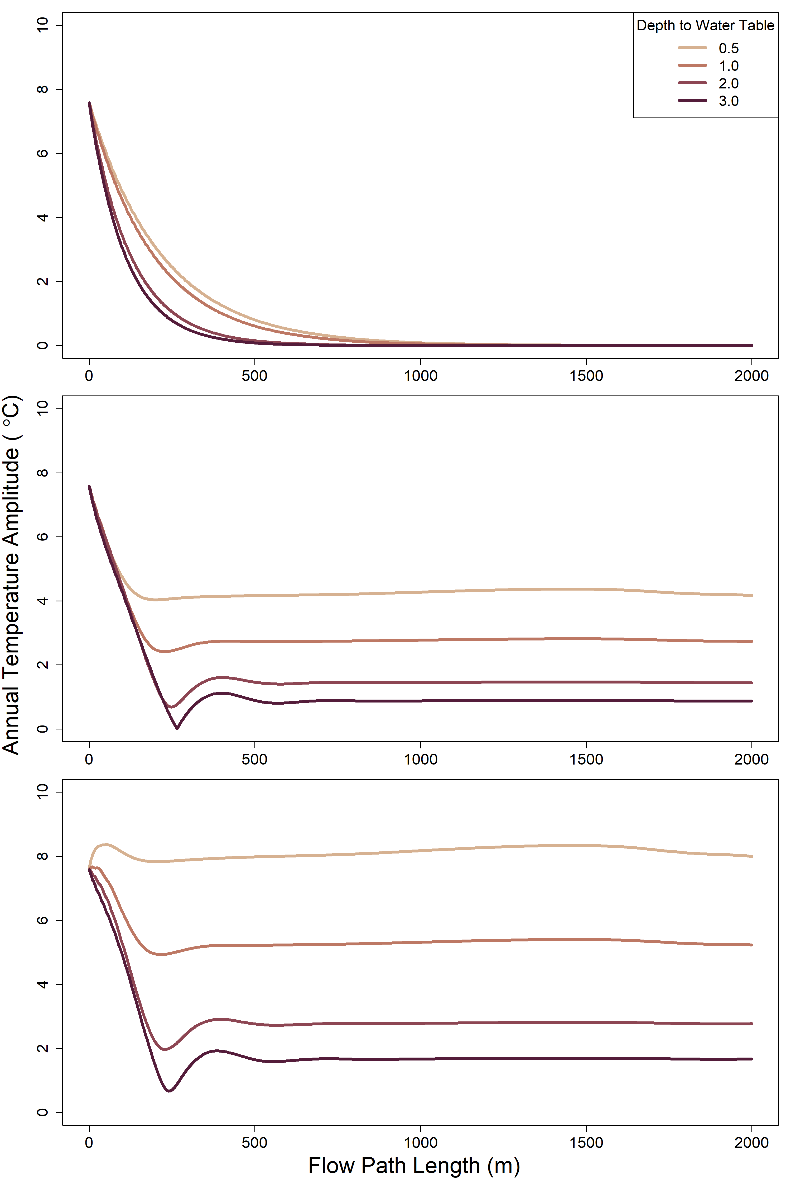
A
B
C

Slide 13
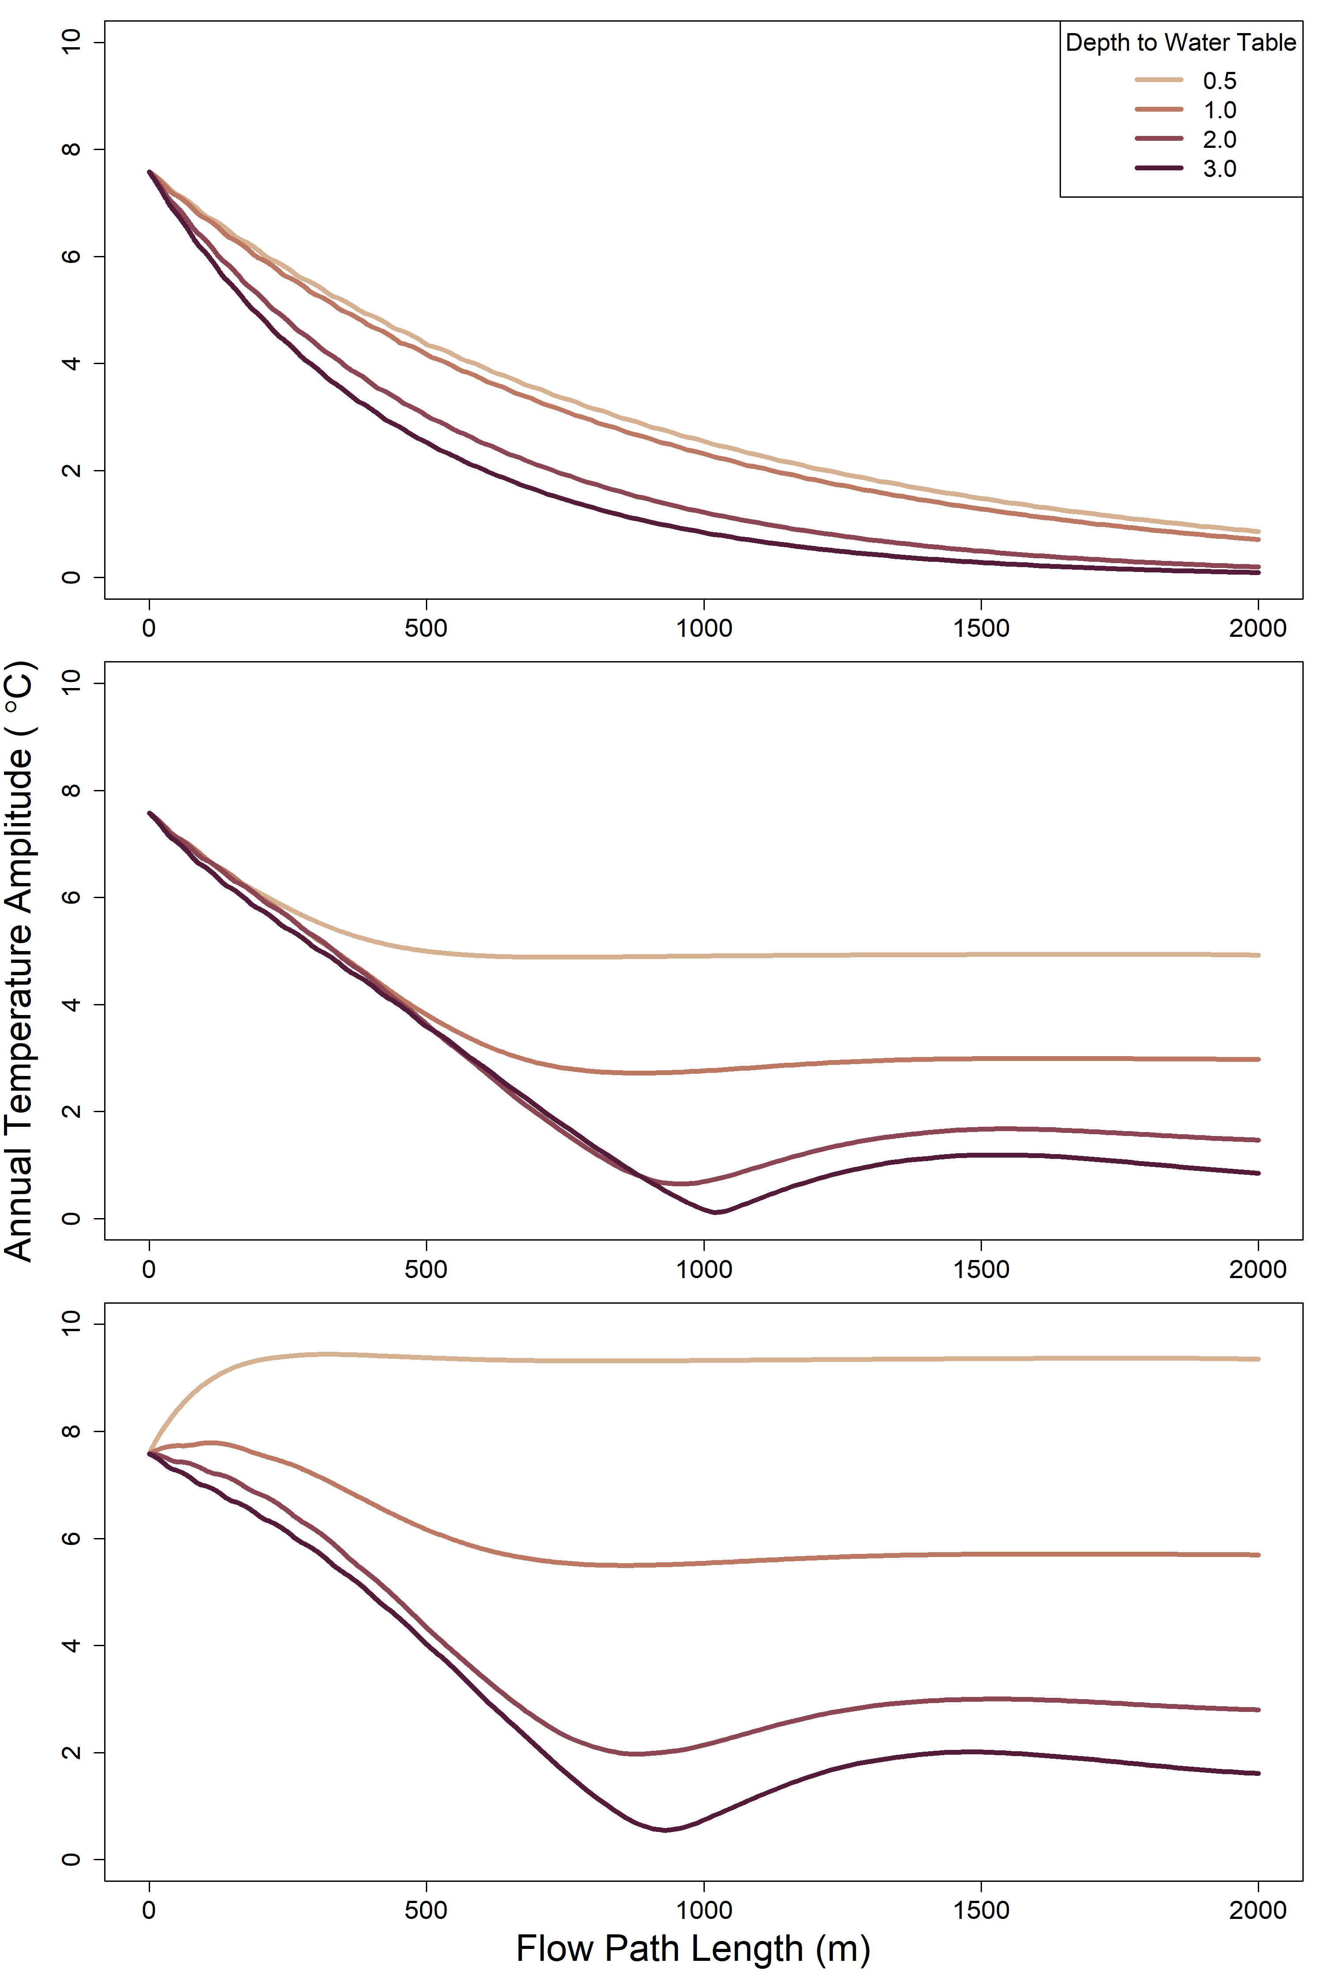
A
B
C

Slide 14
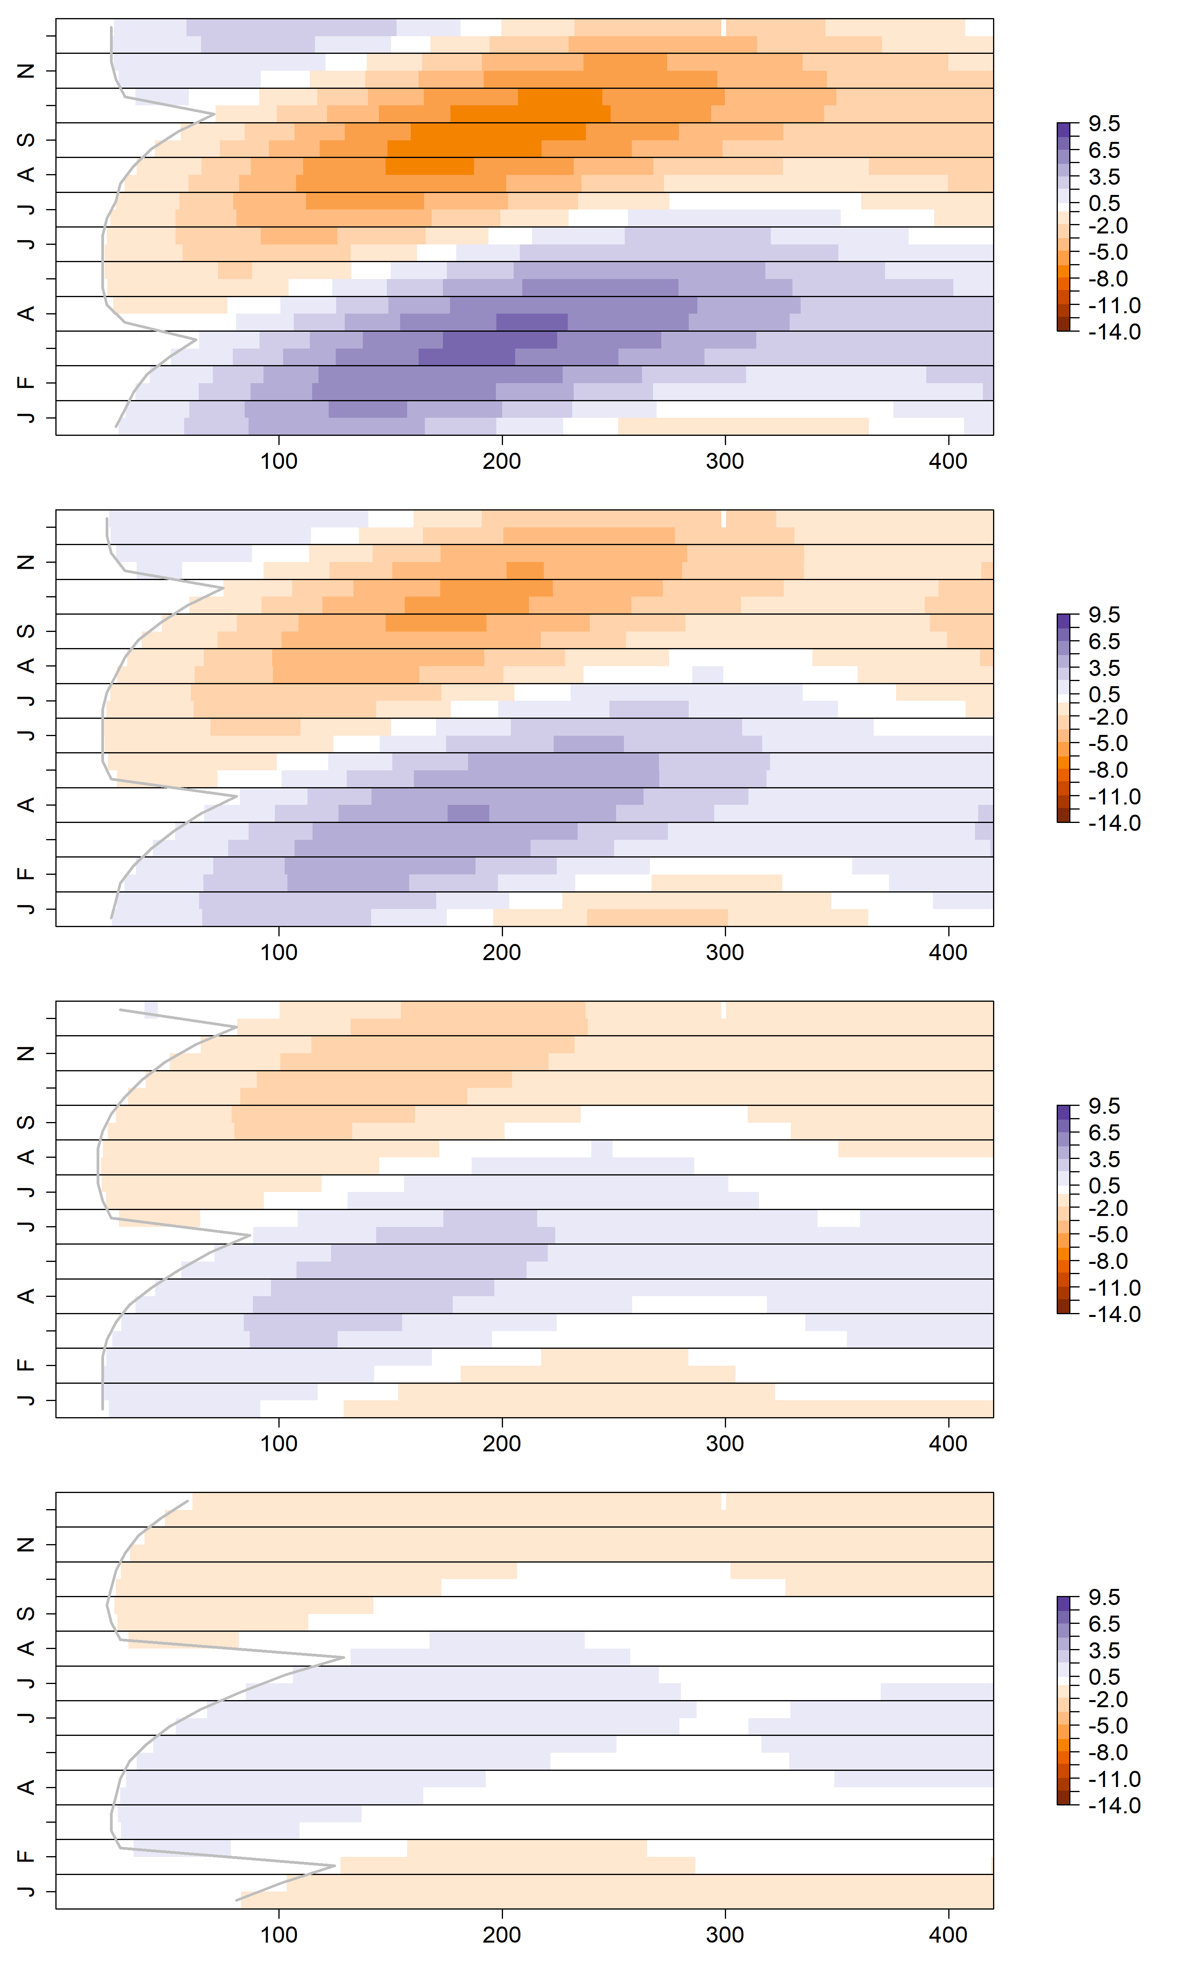
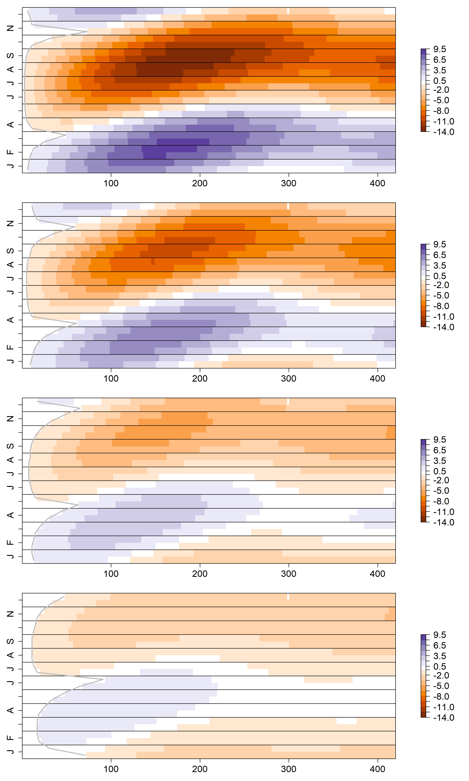
Shady
Sunny
0.5m
1.0m
Month
2.0m
3.0m
Flow Path Length (m)

Slide 15
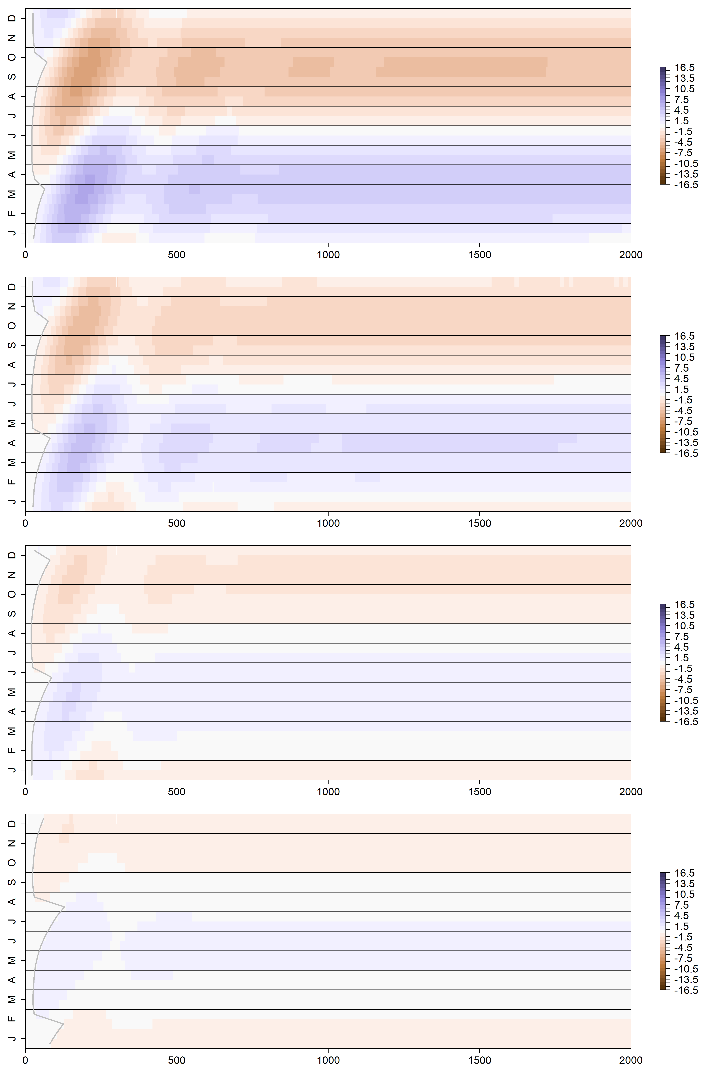
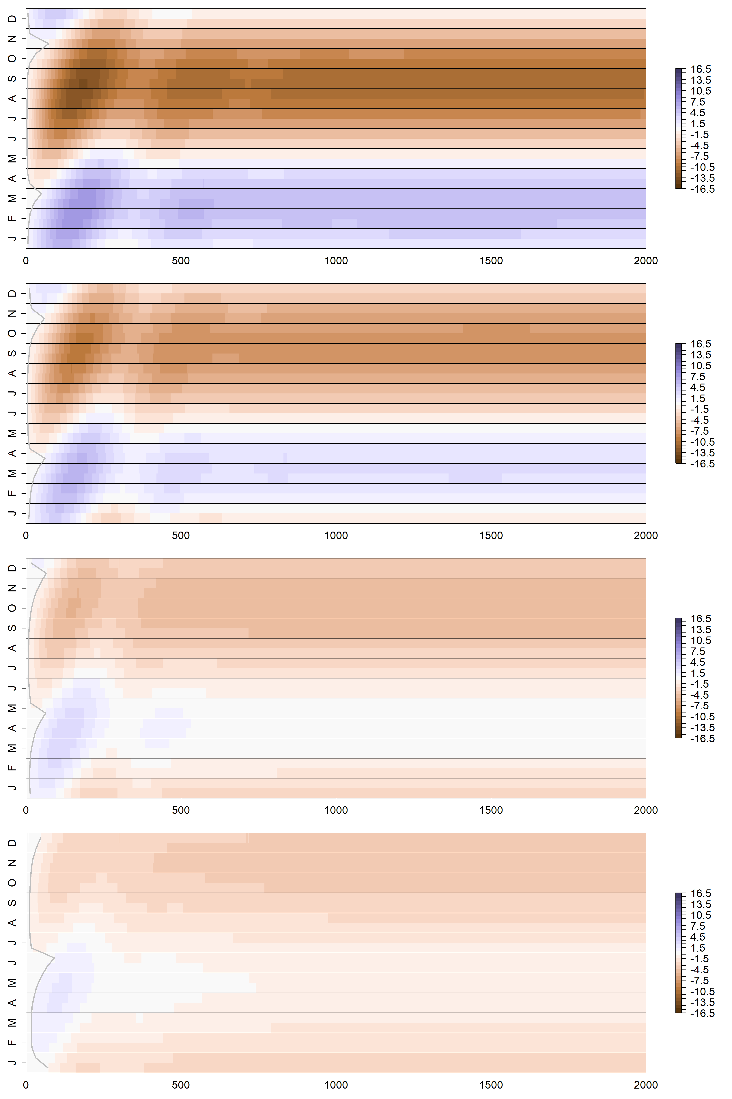
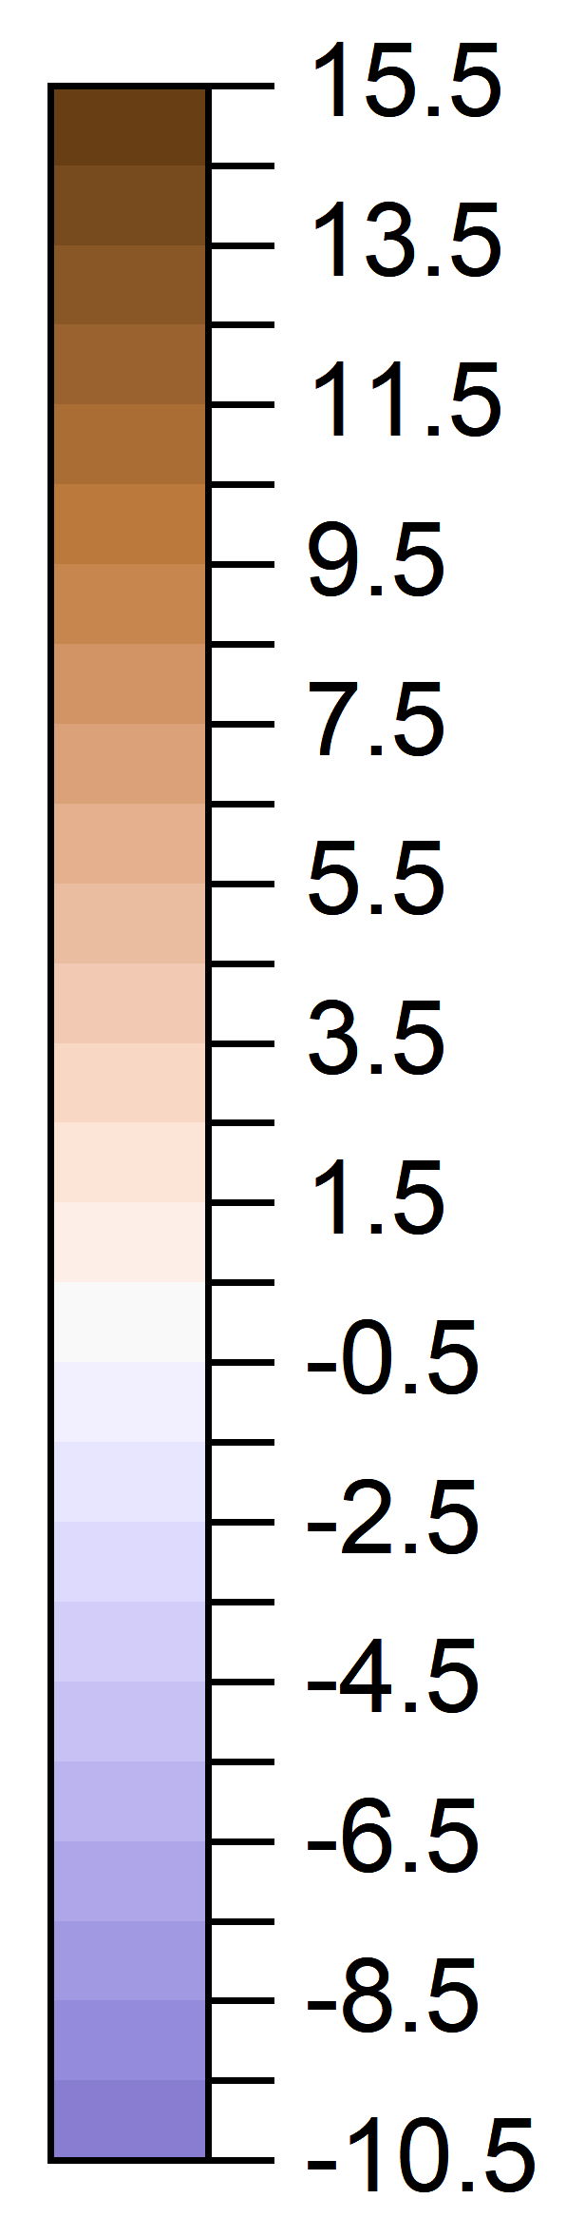
Shady
Sunny
0.5m
1.0m
Month
Unsaturated zone Thickness
Temperature Difference
2.0m
3.0m
Flow Path Length (m)

Slide 16
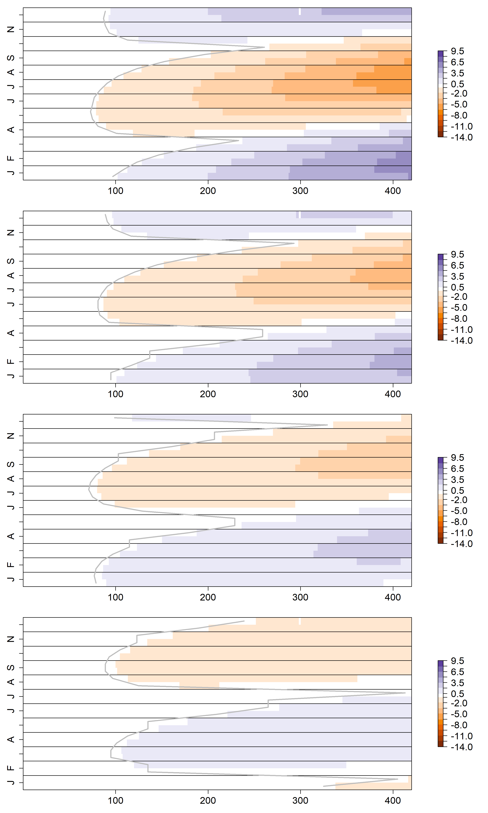
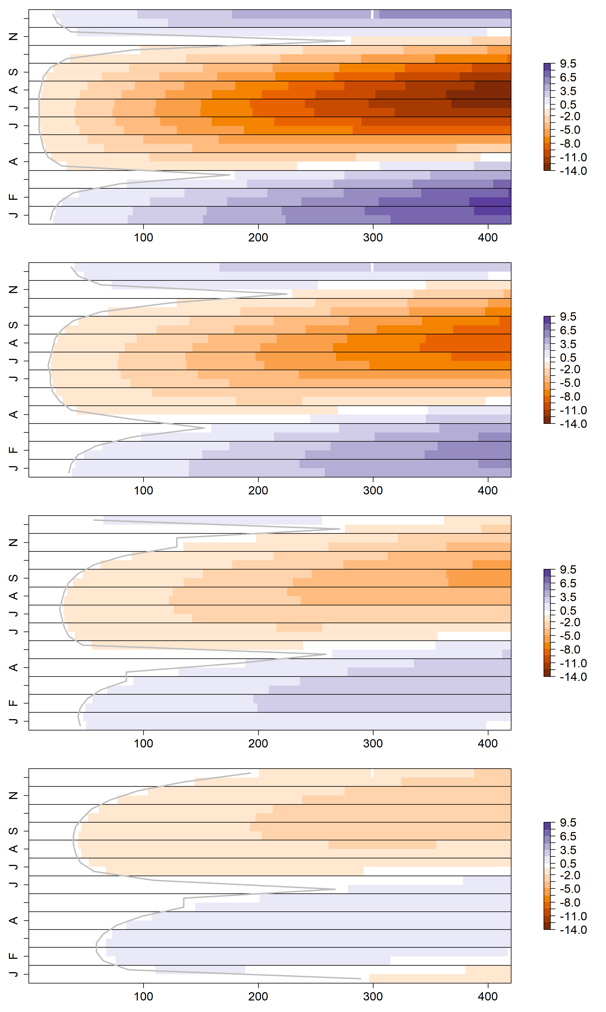
Shady
Sunny
0.5m
1.0m
Month
2.0m
3.0m
Flow Path Length (m)

Slide 17
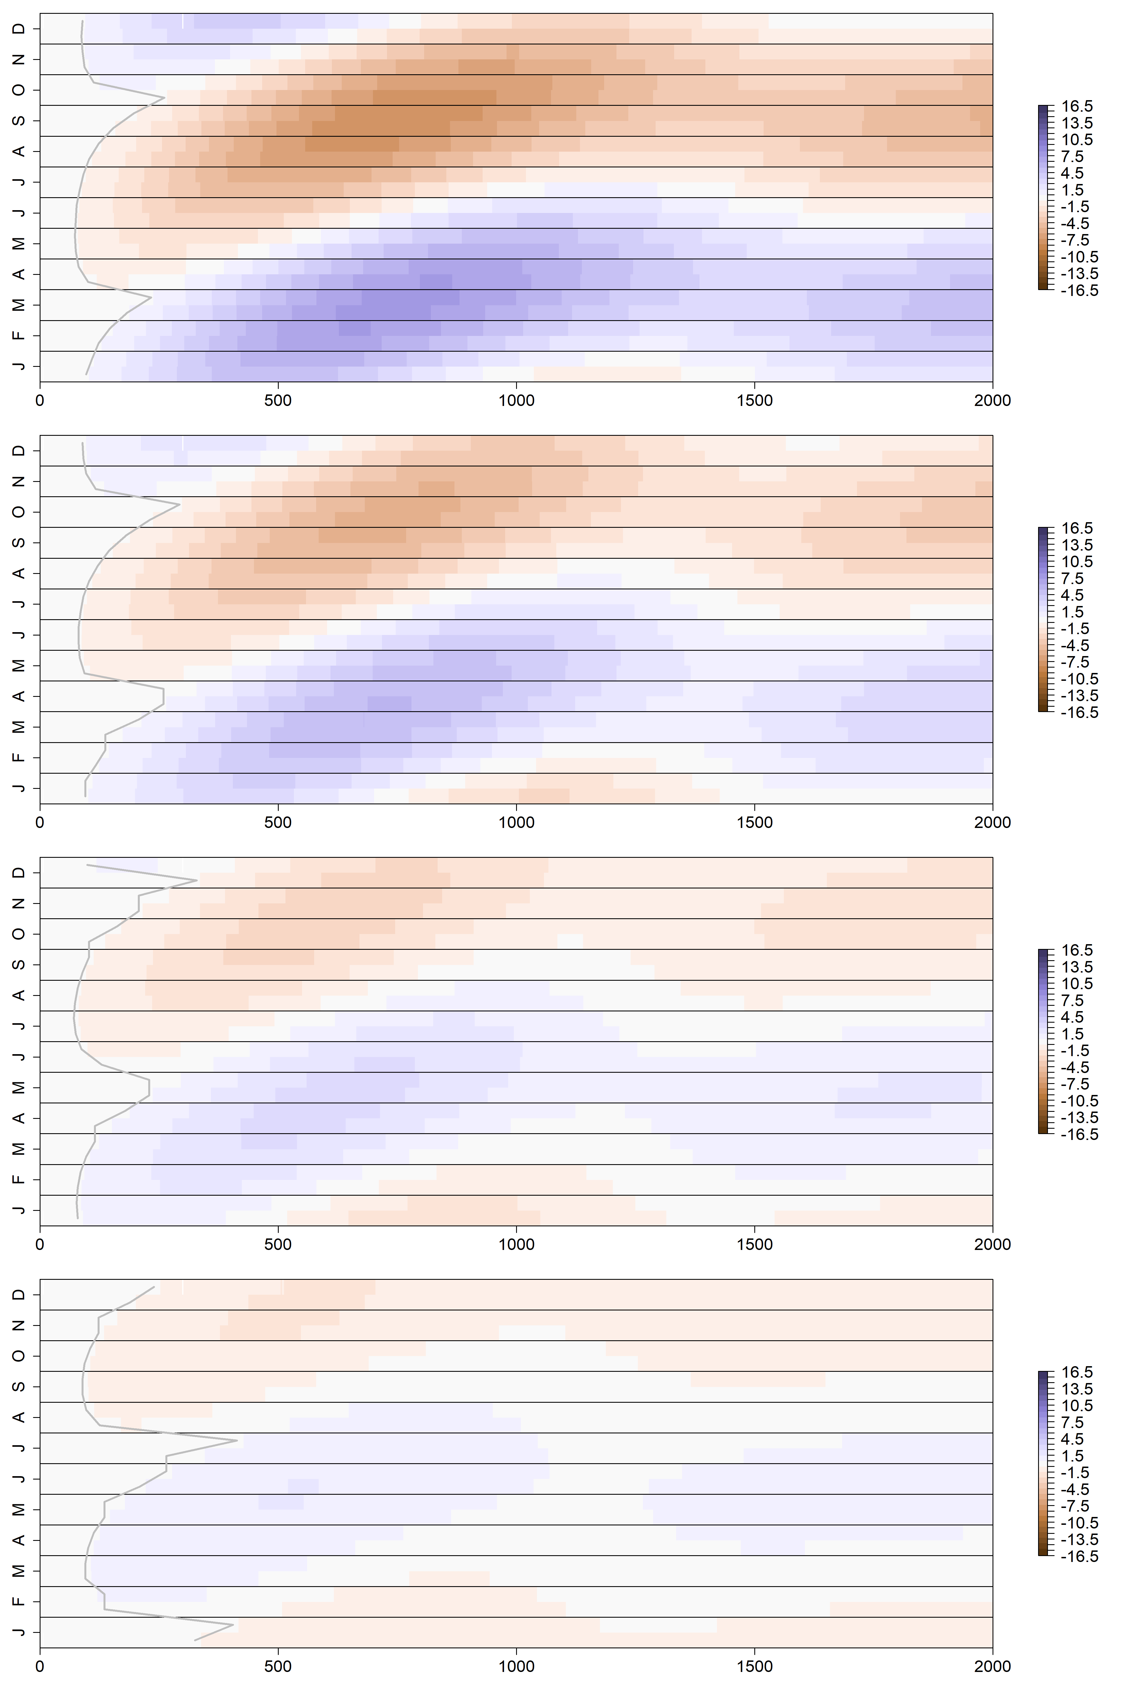
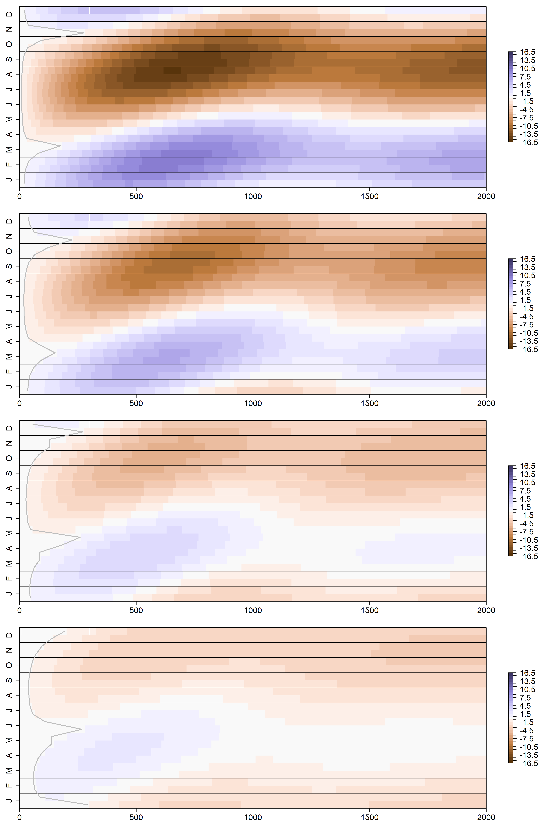
Shady
Sunny
0.5m
1.0m
Month
Unsaturated zone Thickness
Temperature Difference
2.0m
3.0m
Flow Path Length (m)

Slide 18
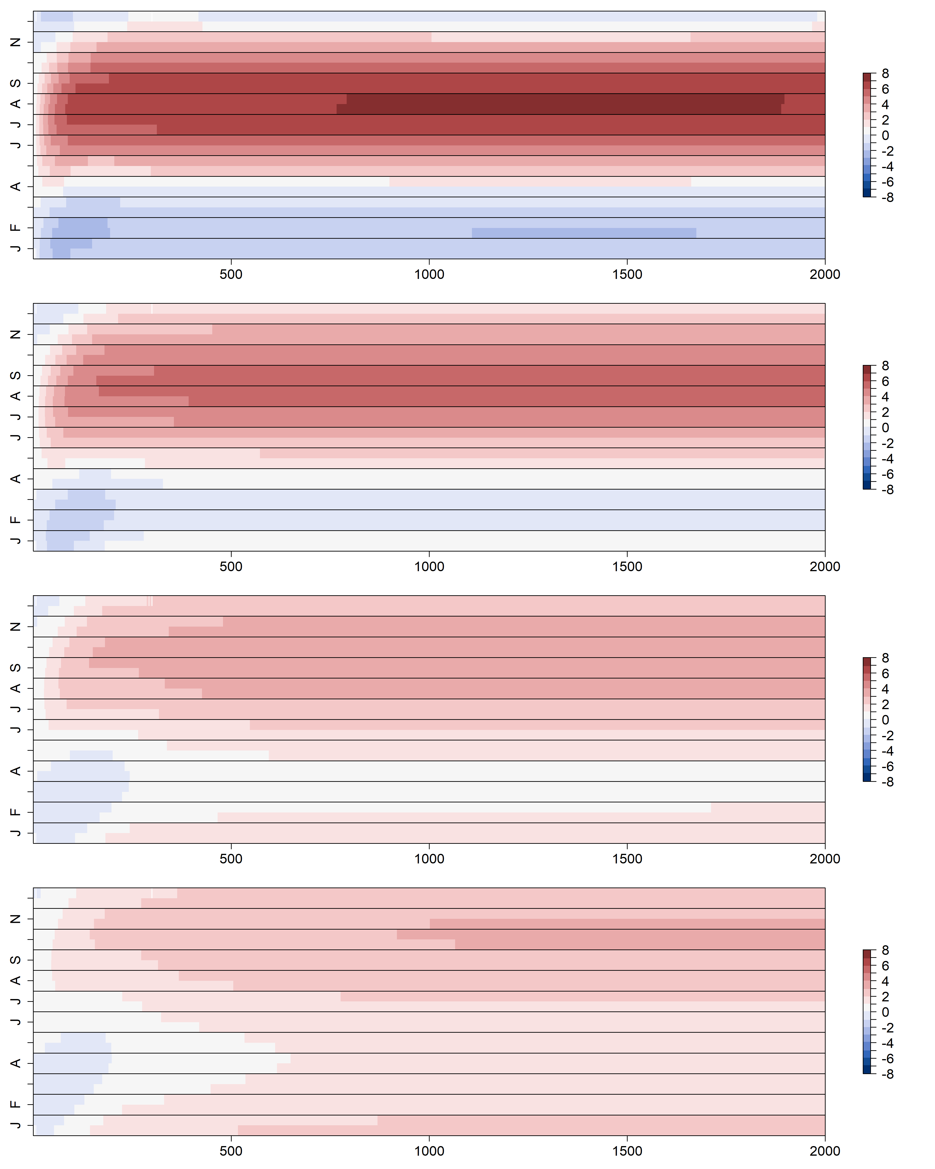
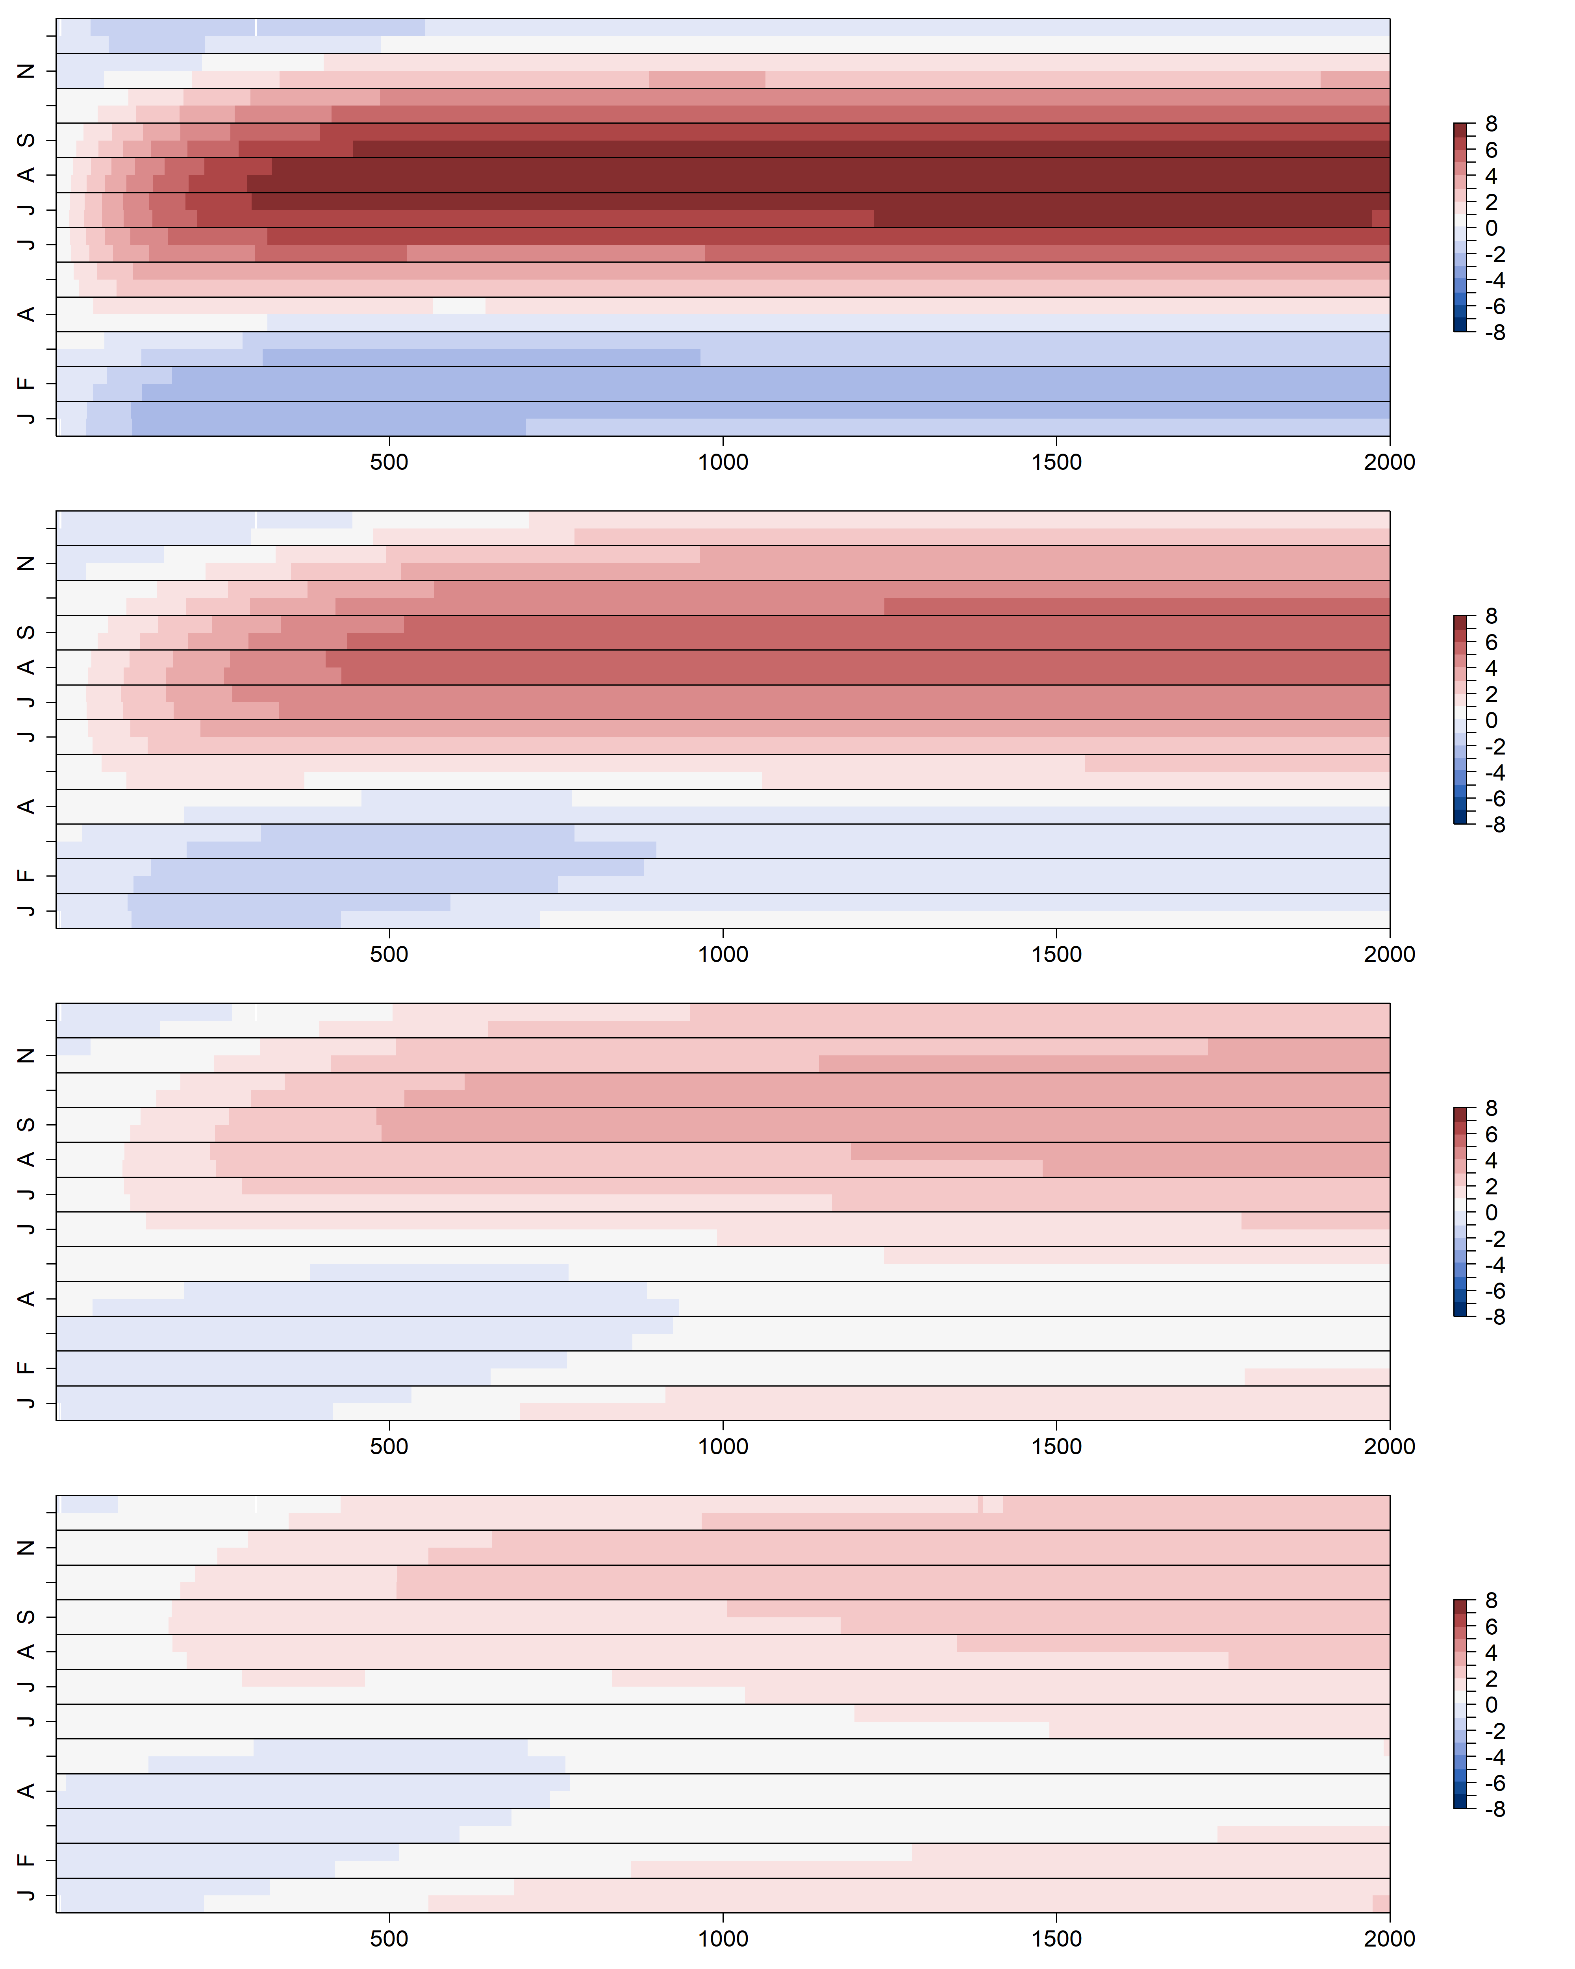
K = 100 m day⁻¹
K = 400 m day⁻¹
0.5 m
1.0 m
Month
2.0 m
3.0 m
Flow Path Length (m)

Slide 19
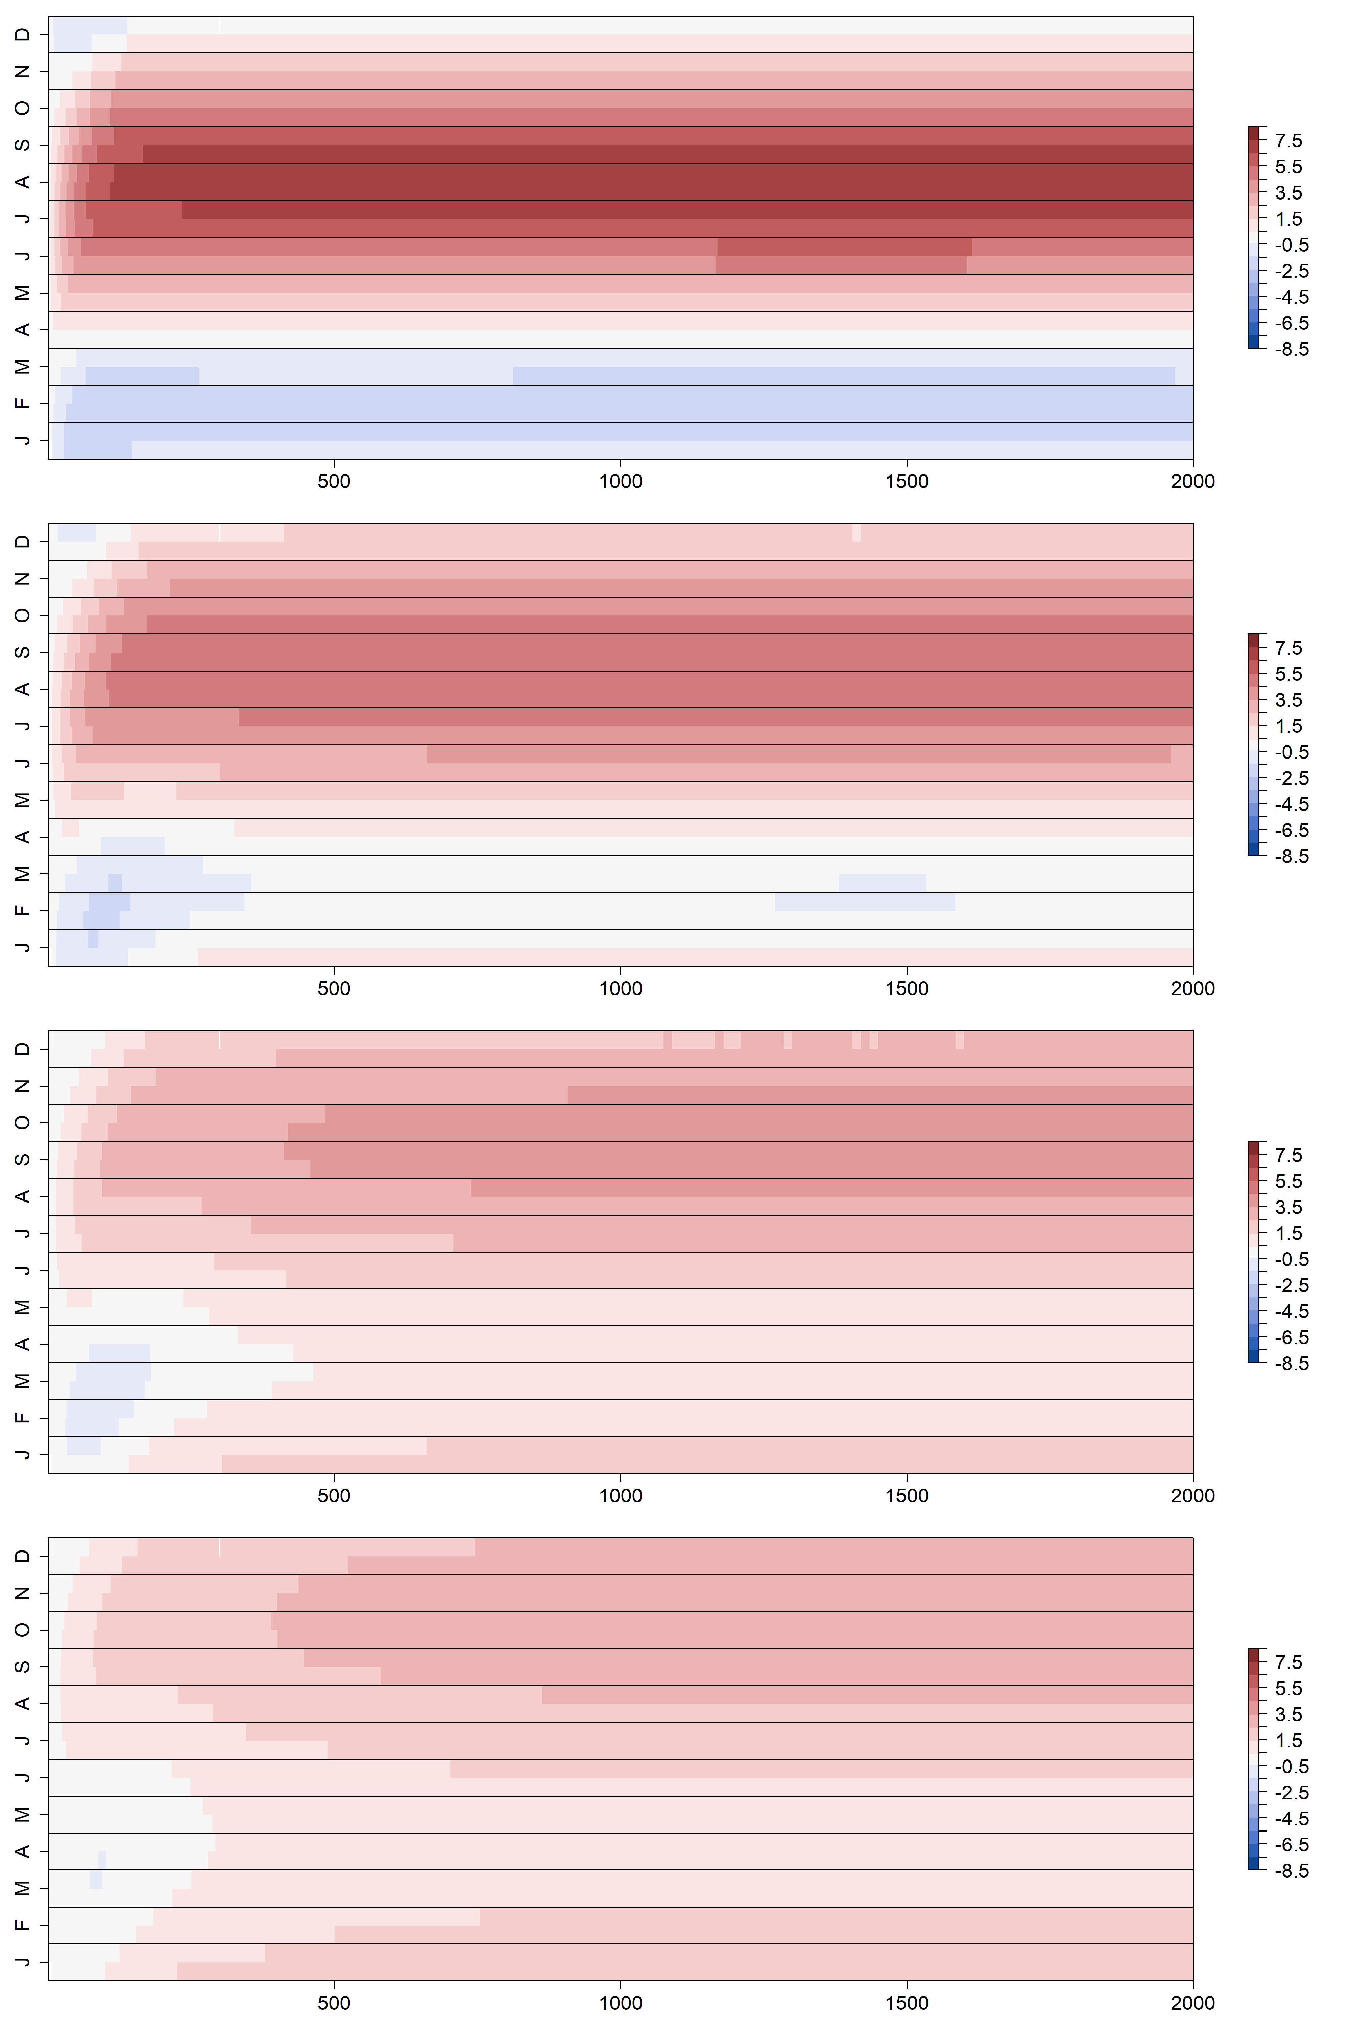
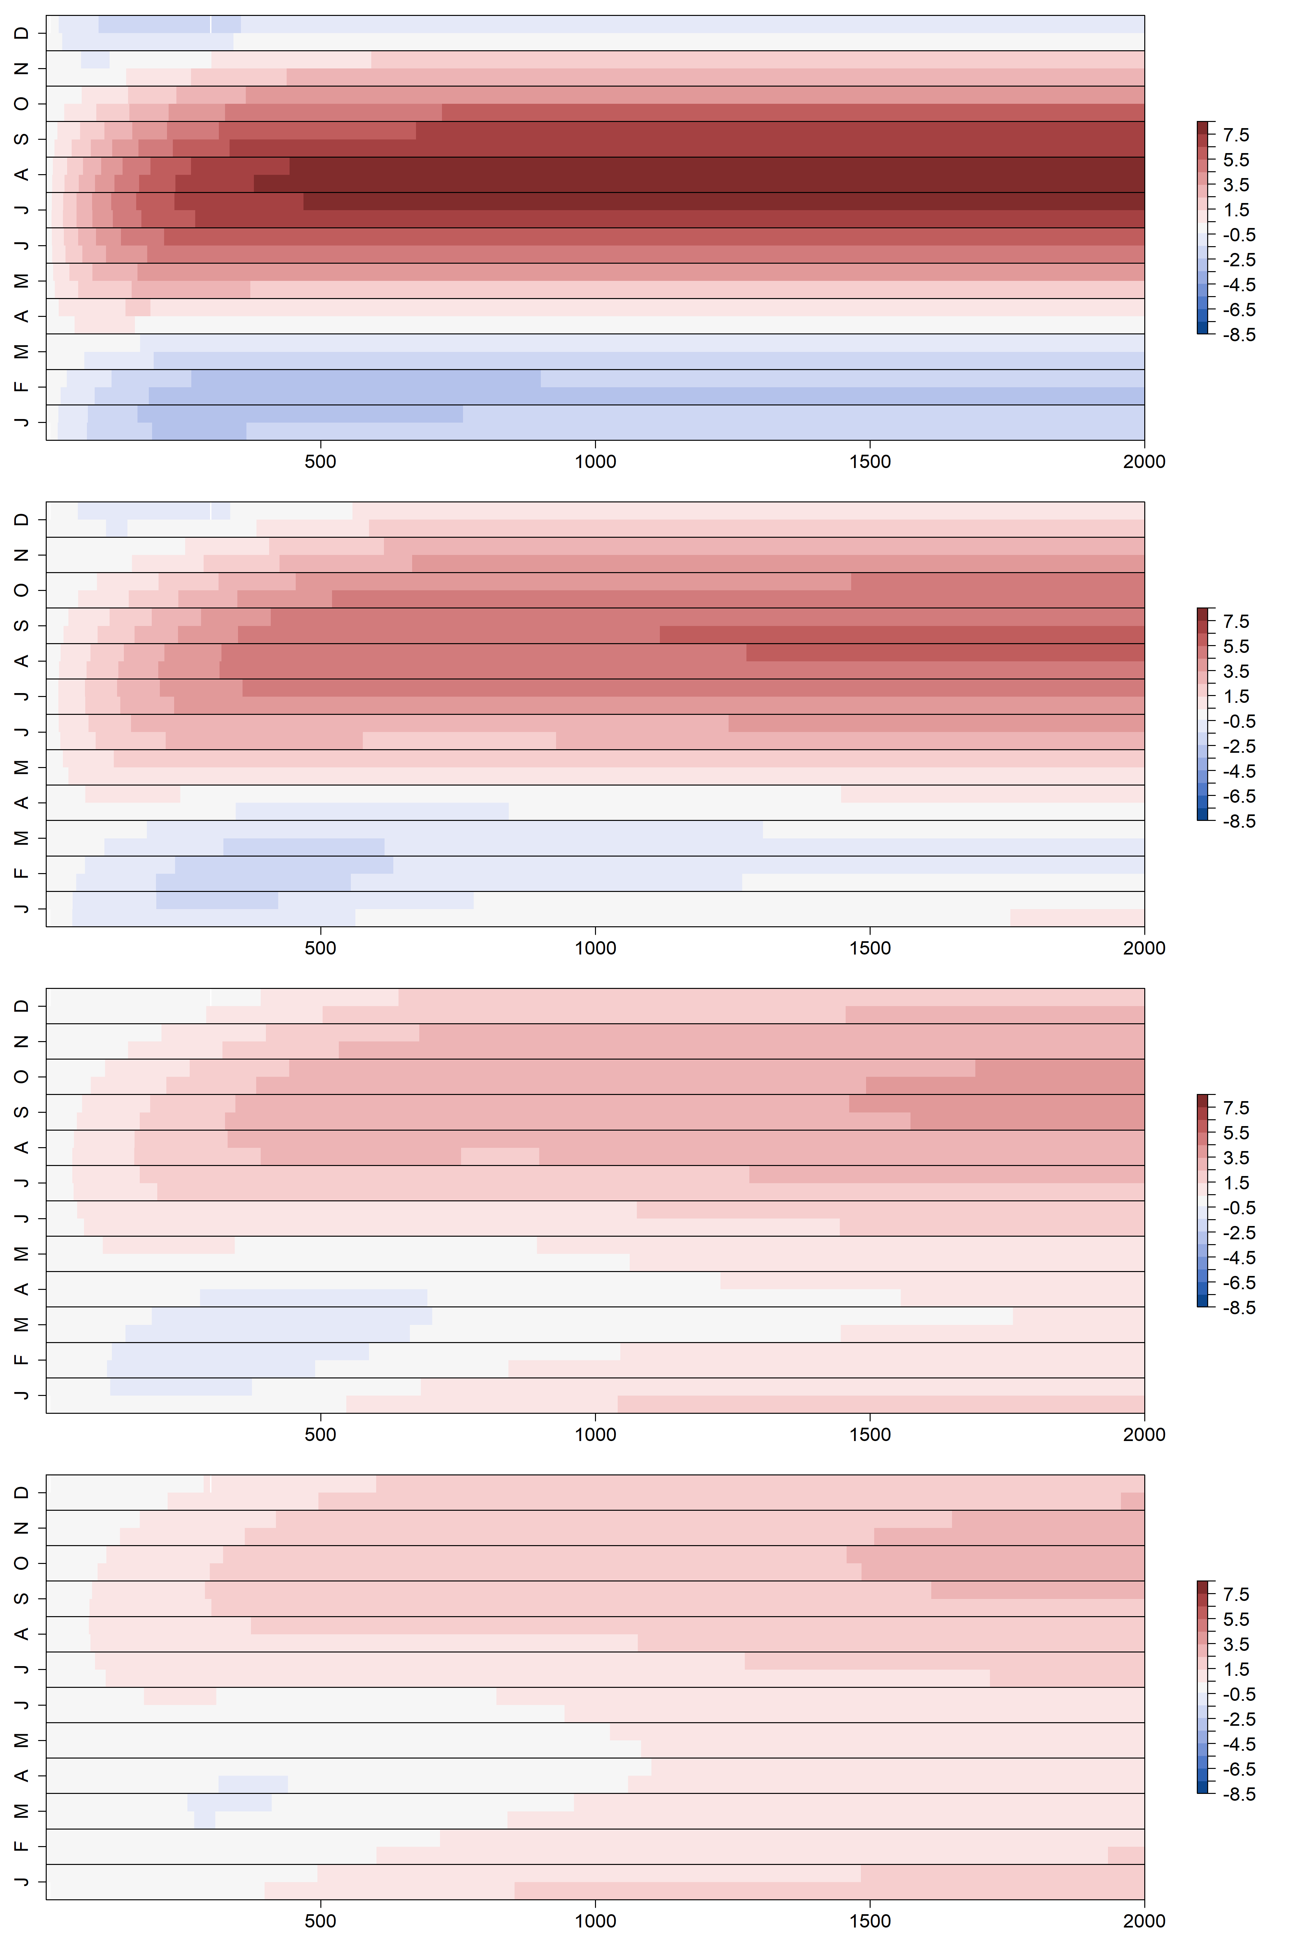
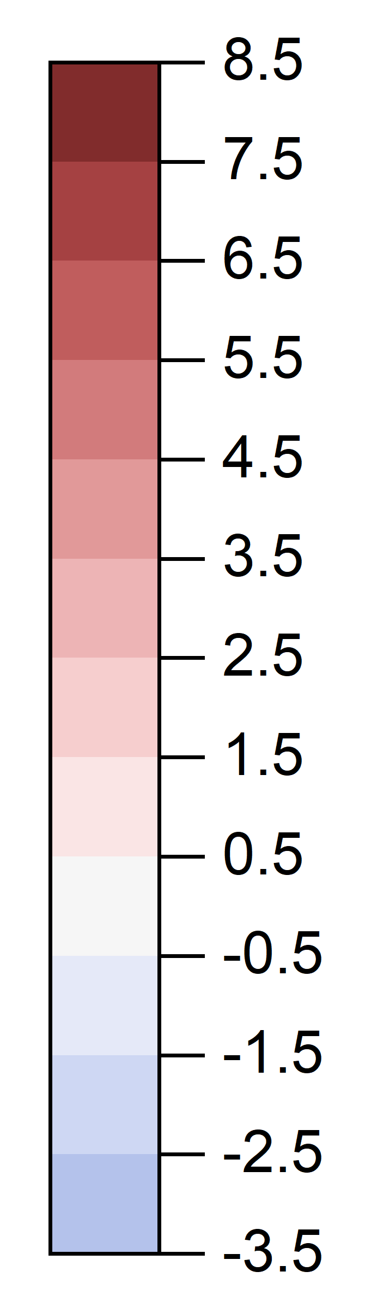
K = 100 m day⁻¹
K = 400 m day⁻¹
0.5 m
1.0 m
Month
Unsaturated zone Thickness
Temperature Difference
2.0 m
3.0 m
Flow Path Length (m)

Slide 20
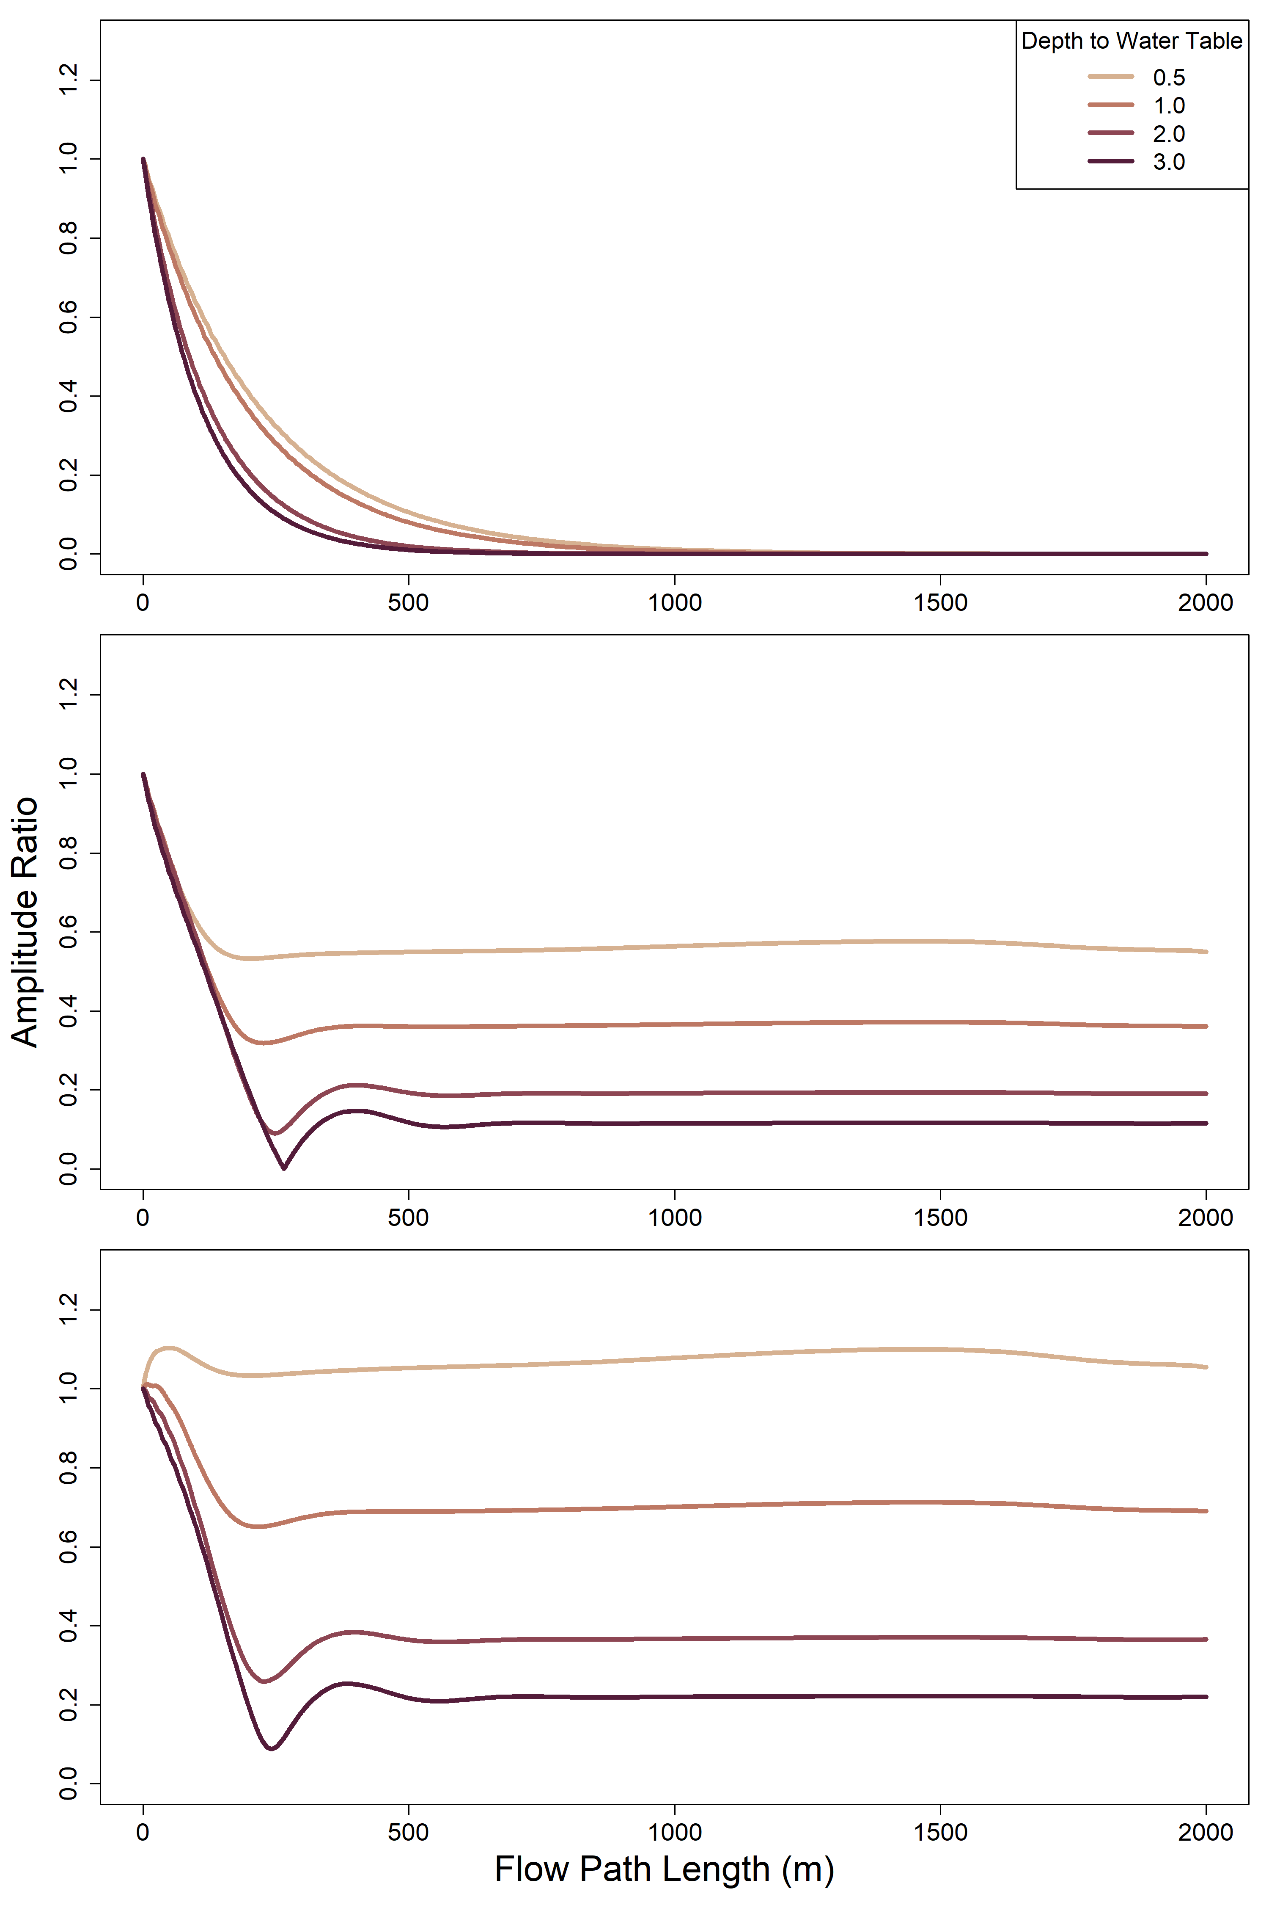
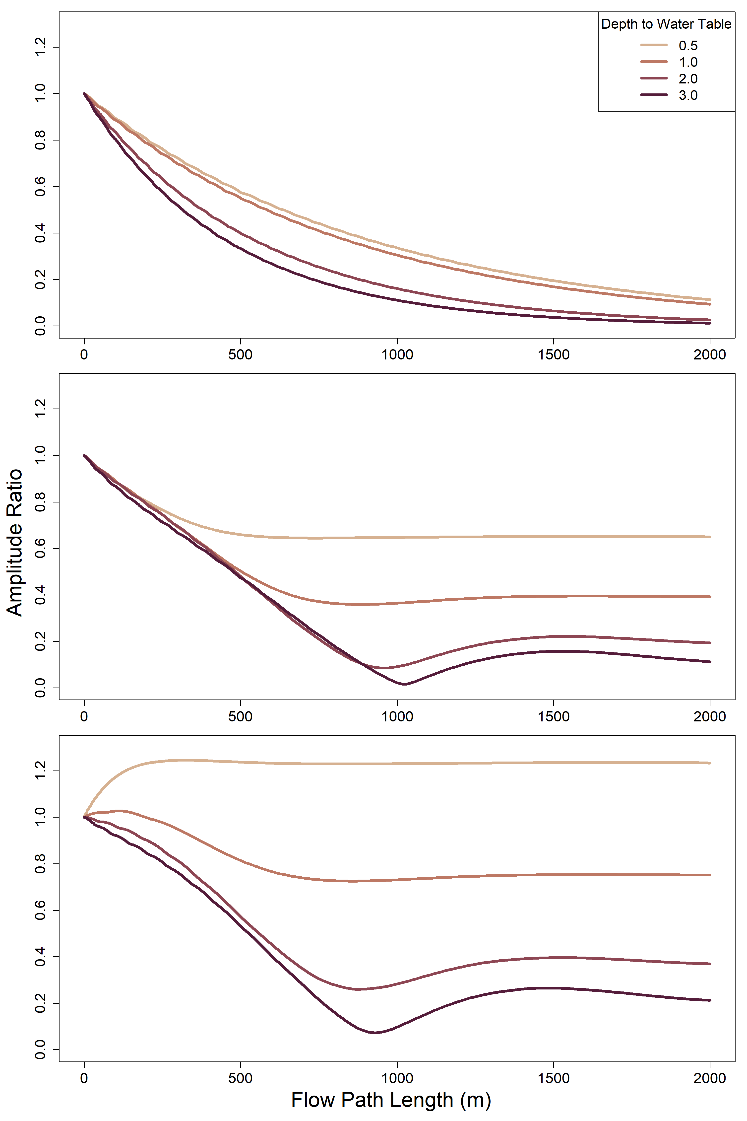
K = 100 m day⁻¹
K = 400 m day⁻¹
River-only
Shady
Sunny

Slide 21
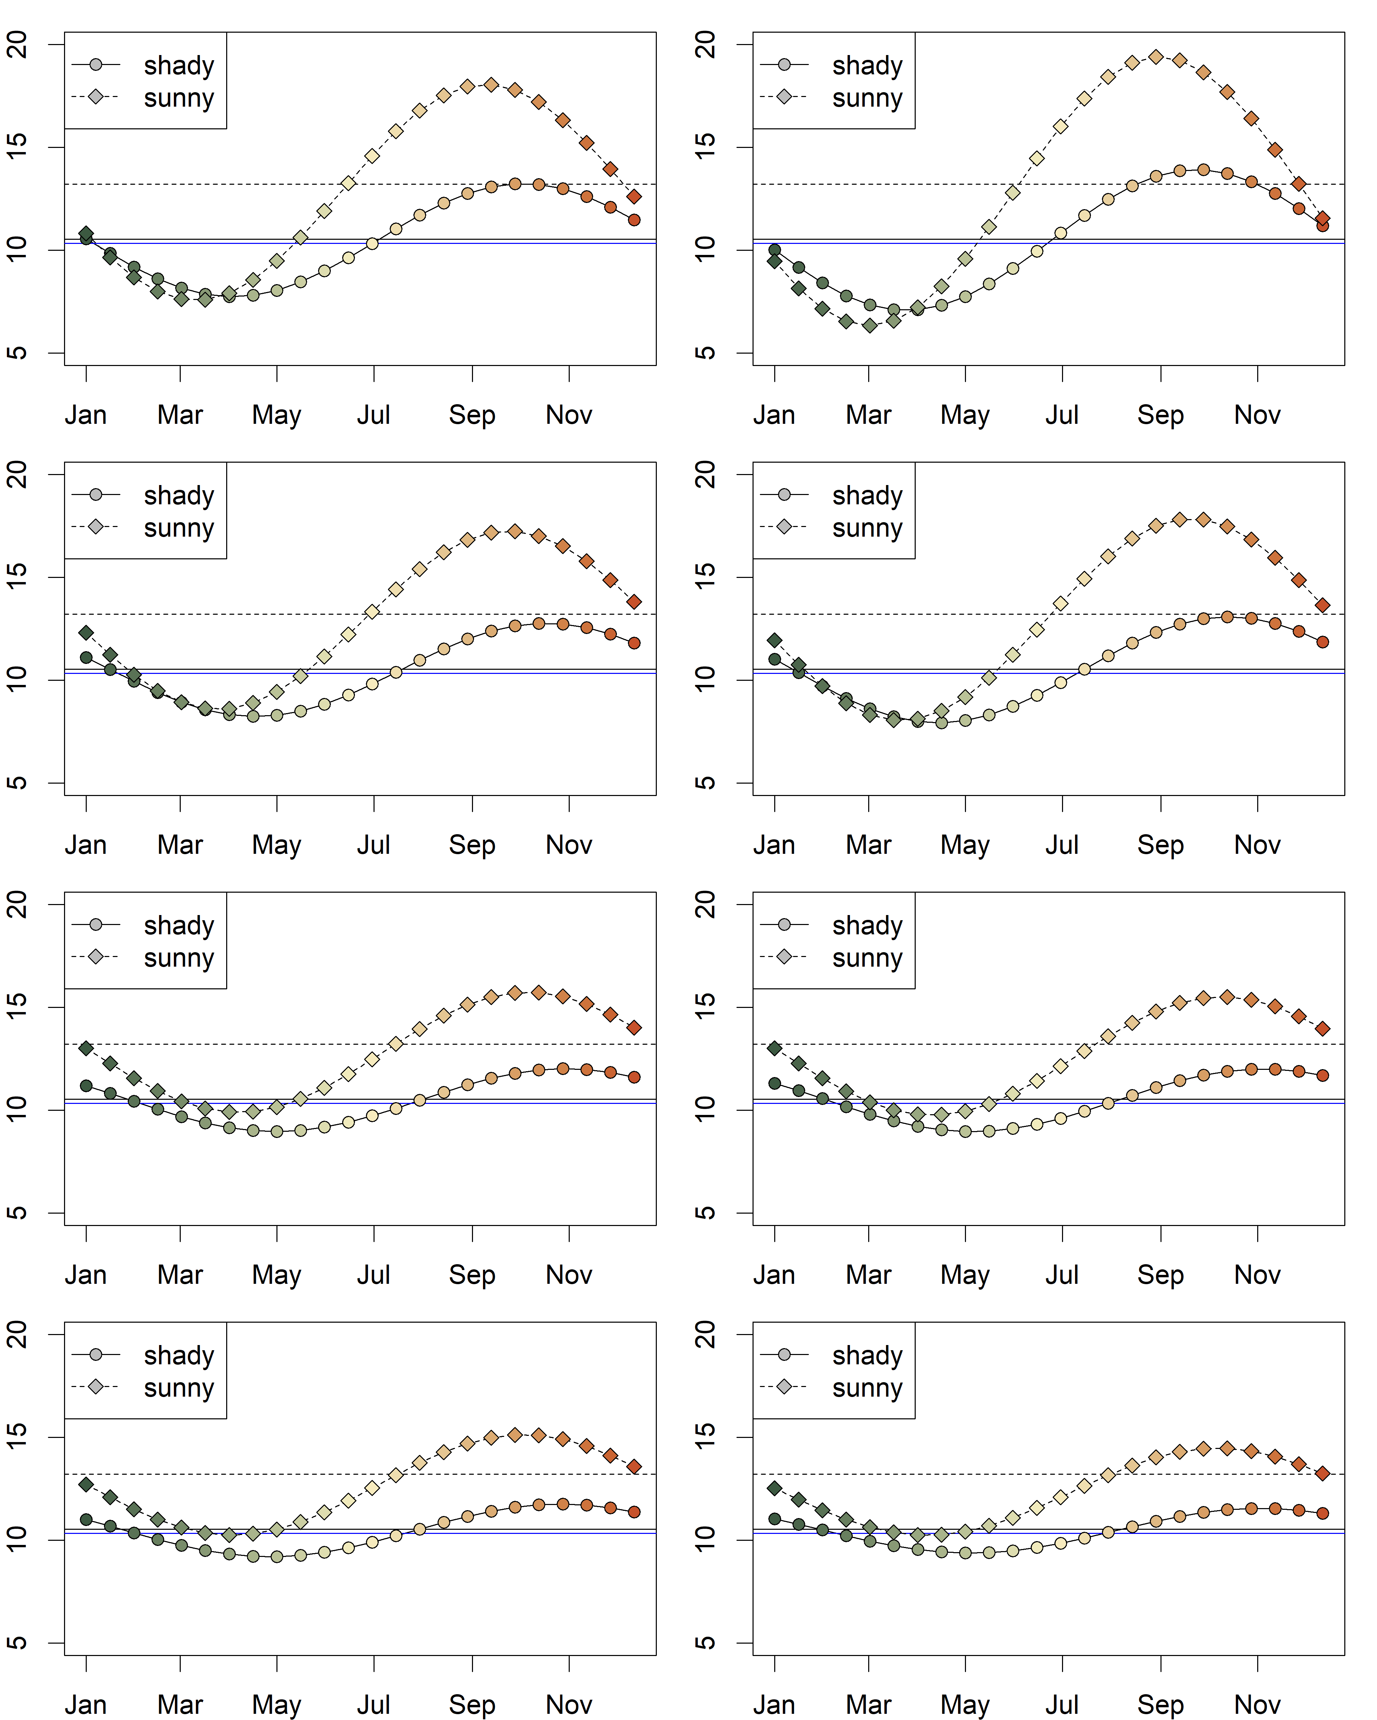
K = 100 m day⁻¹
K = 400 m day⁻¹
0.5m
1.0m
Temperature (°C)
Unsaturated zone Thickness
2.0m
3.0m
Month

Slide 22
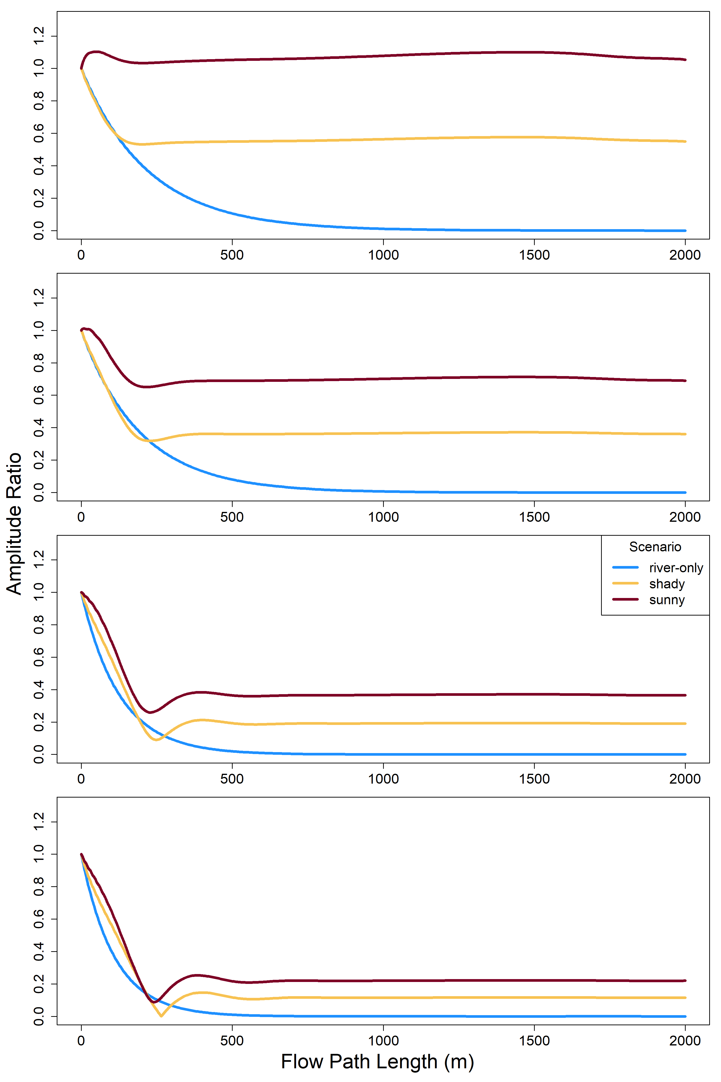
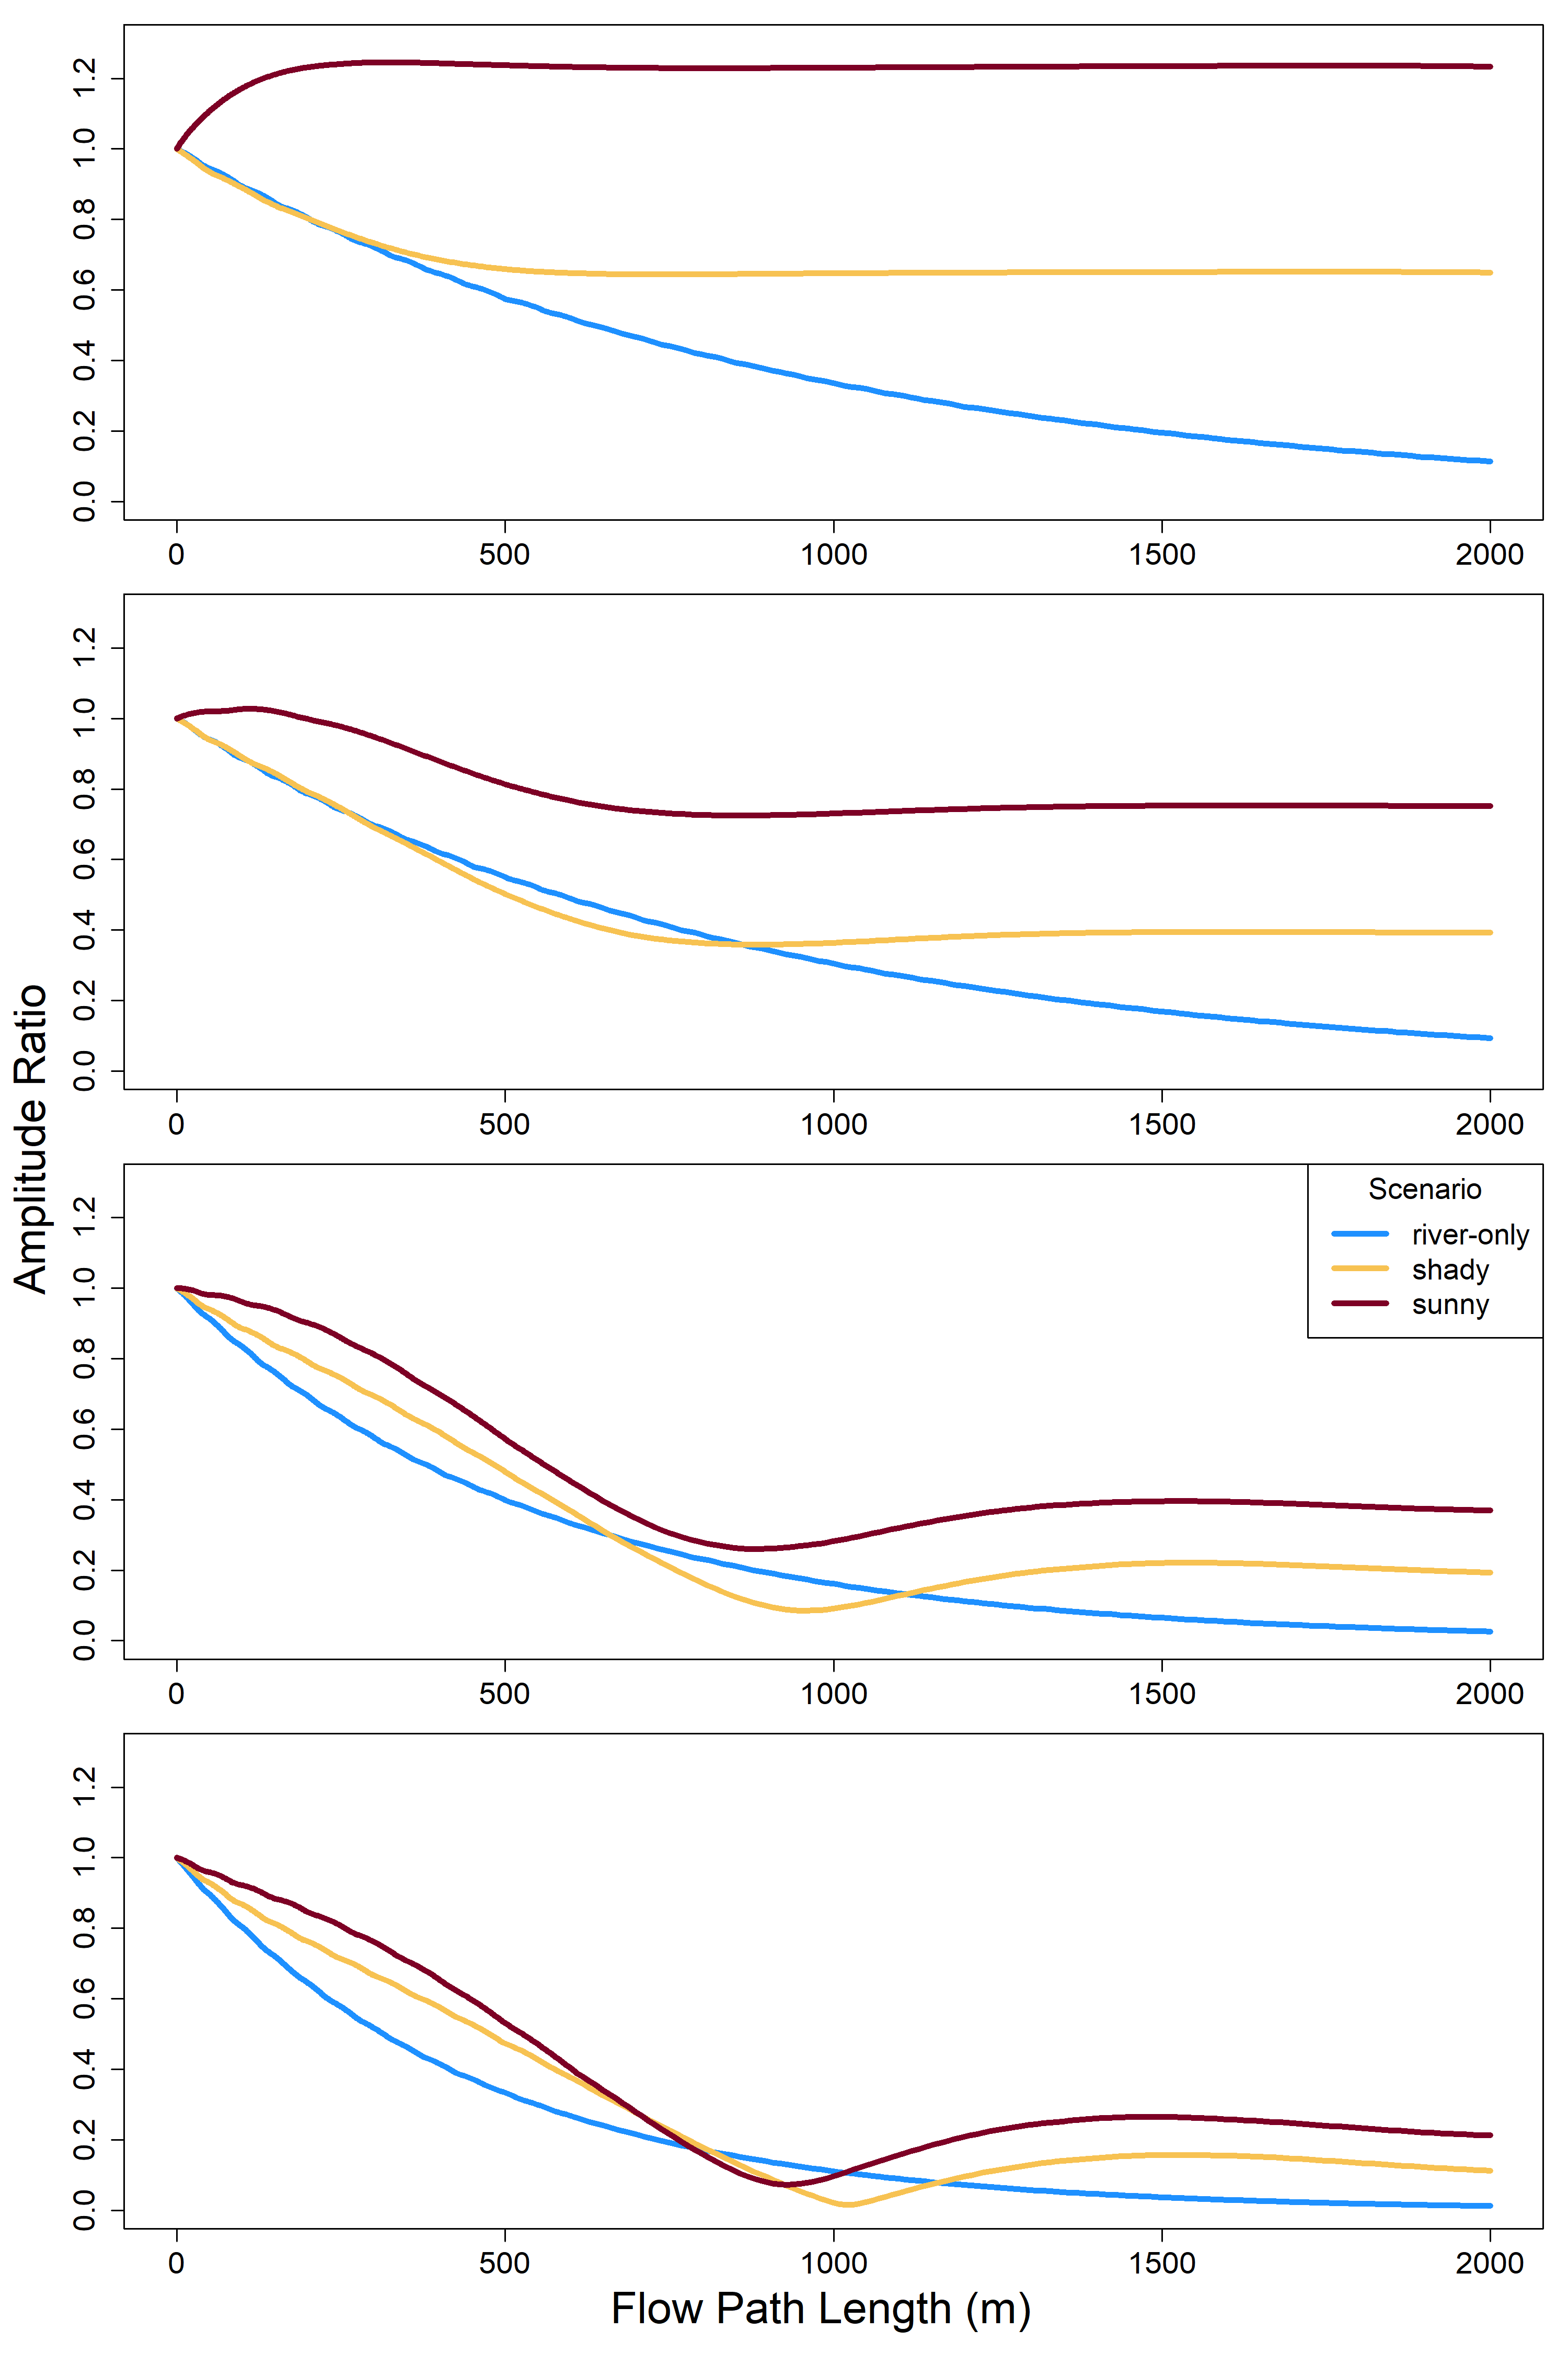
K = 100 m day⁻¹
K = 400 m day⁻¹
0.5m
1.0m
Unsaturated zone Thickness
2.0m
3.0m

